Slide 1
Machine Learning for Predictive Phenotyping from EHR Data
David Page
School of Medicine and Public Health
University of Wisconsin-Madison

Slide 2
Thanks!
NLM, NIGMS, NIH BD2K
International Warfarin Pharmacogenetics Consortium (IWPC)
Wisconsin Genomics Initiative (WGI)
Aubrey Barnard
Kendrick Boyd
Elizabeth Burnside
Michael Caldwell
Jesse Davis
Eric Lantz
Jie Liu
Peggy Peissig
Vitor Santos Costa
Jude Shavlik
Humberto Vidaillet
Jeremy Weiss

Slide 3

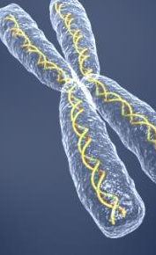

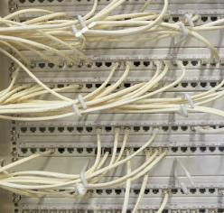
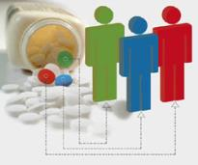
Predictive Personalized
Medicine (WGI)
Individual Patient
G + C + E
Predictive Model for Disease Susceptibility
& Treatment
Response
State-of-the-Art
Machine
Learning
Genetic,
Clinical,
&
Environmental
Data
Personalized
Treatment
Notes:
Data picture is from: http://datalib.ed.ac.uk/GRAPHICS/blue_data.gif
Machine picture is from Microsoft Clip Art j0423067.jpg j0423067.jpg : http://office.microsoft.com/en-us/clipart/results.aspx?qu=computer&sc=20#168
Pill picture is from Microsoft Clip Art j0403705.jpg : http://office.microsoft.com/en-us/clipart/results.aspx?qu=pill&sc=20
Black stick figure picture is from: http://www.austinkleon.com/wp-content/uploads/2008/02/stick_figure.gif
Personalized medicine picture is from: http://www.dnavision.be/images/pharmacogenetics.jpg

Slide 4
The Electronic Health Record (EHR)
Demographics
ID | Year of Birth | Gender
P1 | 3.10.1946 | M
Diagnoses
ID | Date | Diagnosis | Sign/Symptom
P1 | 6.2.2011 | Atrial fibrillation | Discomfort
Notes:
Mlers excel at analyzing large data sets and alternative data sources. EHRs fit those descriptions

Slide 5
The Electronic Health Record (EHR)
Demographics
ID | Year of Birth | Gender
P1 | 3.10.1946 | M
Diagnoses
ID | Date | Diagnosis | Symptoms
P1 | 2011.06.02 | Atrial fibrillation | Dizzy, discomfort
ID | Date | Diagnosis | Sign/Symptom
P1 | 7.3.2011 | Atrial fibrillation | Dizziness, Nausea
Notes:
Mlers excel at analyzing large data sets and alternative data sources. EHRs fit those descriptions

Slide 6
The Electronic Health Record (EHR)
Demographics
ID | Year of Birth | Gender
P1 | 3.10.1946 | M
Diagnoses
ID | Date | Diagnosis | Symptoms
P1 | 2011.06.02 | Atrial fibrillation | Dizzy, discomfort
ID | Date | Diagnosis | Symptoms
P1 | 2011.06.02 | Atrial fibrillation | Dizzy, discomfort
ID | Date | Diagnosis | Sign/Symptom
P1 | 2.2.2012 | Stroke | Schizophasia
Notes:
Mlers excel at analyzing large data sets and alternative data sources. EHRs fit those descriptions

Slide 7
The Electronic Health Record (EHR)
Demographics
ID | Year of Birth | Gender
P1 | 3.10.1946 | M
Diagnoses
ID | Date | Diagnosis | Sign/Symptom
P1 | 6.2.2011 | Atrial fibrillation | Discomfort
P1 | 7.3.2011 | Atrial fibrillation | Dizziness, Nausea
P1 | 2.2.2012 | Stroke | Schizophasia
Notes:
Mlers excel at analyzing large data sets and alternative data sources. EHRs fit those descriptions

Slide 8
Electronic Medical Record (EMR)
Demographics
Diagnoses
Lab Results
Vitals
Medications
Notes:
On the second day the knee was better, and on the third day it disappeared; The patient has been depressed since she began seeing me in 1993; Discharge status: Alive but without my permission; The patient refused autopsy; Patient’s medical history has been remarkably insignificant with only a 40 pound weight gain in the past three days; She is numb from her toes down; The skin was moist and dry; Occasional, constant infrequent headaches; Patient was alert and unresponsive; Rectal examination revealed a normal size thyroid; I saw your patient today, who is still under our car for physical therapy; Skin: somewhat pale but present; Patient was seen in consultation by Dr. Blank, who felt we should sit on the abdomen and I agree; Large brown stool ambulating in the hall; Patient has two teenage children, but no other abnormalities.

Slide 9
Sample Input Data Set
Patient | Gender | Age | Hypertension within last year | ... | Average LDL last 5 years | Statin | MI in next 5 years
P1 | F | 32 | No | ... | 120 | No | No
P2 | F | 45 | Yes | ... | 154 | No | No
P3 | M | 24 | No | ... | 136 | No | No
P4 | M | 58 | Yes | ... | 210 | No | Yes
... | ... | ... | ... | ... | ... | ... | ...

Slide 10
Supervised Learning Specification
Given: Values of the input features and the output feature (response, class) for many patients
Do: Build a model that can accurately predict the unknown value of the output class for new (previously unseen) patients whose values of the input features are known

Slide 11
Issues in Phenotyping
Explanatory Phenotyping
  Who really had a myocardial infarction (MI) and when?
  Patient was on different doses of Warfarin – what was the stable dose?
Predictive Phenotyping
  Who will have an MI in the next year?
  Who will have an MI in the next year if they take this drug?
  What will be the stable dose of Warfarin for this patient?
Causal Discovery
  How much will patient reduce risk of MI if he stops smoking?
  Was the MI caused by the drug? (Would patient have had MI anyway? As soon?)
  Is there some adverse drug event (ADE) being caused by this drug, and we don’t even know what it is?

Slide 12
Issues in Phenotyping
Explanatory Phenotyping
  Who really had a myocardial infarction (MI) and when?
  Patient was on different doses of Warfarin – what was the stable dose?
Predictive Phenotyping
  Who will have an MI in the next year?
  Who will have an MI in the next year if they take this drug?
  What will be the stable dose of Warfarin for this patient?
Causal Discovery
  How much will patient reduce risk of MI if he stops smoking?
  Was the MI caused by the drug? (Would patient have had MI anyway? As soon?)
  Is there some adverse drug event (ADE) being caused by this drug, and we don’t even know what it is?

Slide 13
IWPC - 21 research groups
4 continents and 9 countries
Asia
  Israel, Japan, Korea, Taiwan, Singapore
Europe
  Sweden, United Kingdom
North America
  USA (11 states: Alabama, California, Florida, Illinois, Missouri, North Carolina, Pennsylvania, Tennessee, Utah, Washington, Wisconsin)
South America
  Brazil

Slide 14
Dataset
5,700 patients treated with warfarin
Demographic characteristics
Primary indication for warfarin treatment
Stable therapeutic dose of warfarin
Treatment INR
Target INR
  5,052 patients with a target INR of 2-3
Concomitant medications
  Grouped by increased or decreased effect on INR
Presence of genotype variants
  CYP2C9 (*1, *2 and *3)
  VKORC1 (one of seven SNPs in linkage disequilibrium)
    blinded re-genotyping for quality control

Slide 15
Age, height and weight

Slide 16
Race, inducers and amiodarone

Slide 17
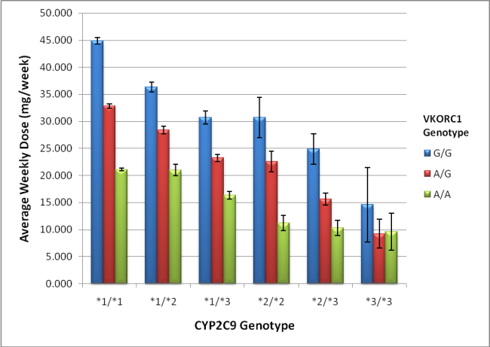
CYP2C9 and VKORC1 genotypes

Slide 18
Statistical Analysis
Derivation Cohort
  4,043 patients with a stable dose of warfarin and target INR of 2-3 mg/week
  Used for developing dose prediction models
Validation Cohort
  1,009 patients (20% of dataset)
  Used for testing final selected model
Analysis group did not have access to validation set until after the final model was selected

Slide 19
IWPC pharmacogenetic dosing algorithm
**The output of this algorithm must be squared to compute weekly dose in mg
^All references to VKORC1 refer to genotype for rs9923231

Slide 20
Model comparisons

Slide 21
Adverse Drug Events: Cox-2 Inhibitors Example
Dec. 1998-May 1999,
Celebrex, Vioxx approved
2001,
Cox-2 sales top
$6 billion/year in US
2002,
Beginning of
APPROVe Study
Sept 2004,
Vioxx voluntarily
pulled from market
Dec. 2004,
FDA issues warning
April 2005,
FDA removes
Bextra from market
Notes:
These are pain relievers that don’t cause gastric problems.

Slide 22
Predicting MI Given Cox2 Inhibitor (Davis et al., 2009)

Slide 23
Our Relational Learning Approach
Prescribe
Terconazole?
Adverse
Reaction?
Patient’s
history
PID Date Medication Dose
PID Date Weight
P1 2/2/03 Warfarin 10mg
P1 2/2/03 120
Given: Patient’s clinical history
Predict: At prescription time if the patient will
have an adverse reaction to drug

Slide 24
More Detail
Integrates feature induction and model construction
If-then rules capture implicit, relational features
Rules become features in statistical model
Drug(p,Terconazole) ˄ Wt(p, w) ˄ w <120 ⇒ ADR(p)
ADR
Rule 1
Rule 5
Rule 13
…
Rule M

Slide 25
More Detail
ADR
Rule 1
Rule 5
Rule 13
…
Rule M
Candidate Rules:
R₁
R₂
R₃
R₄
R₅
…
R_{n}
Δ Model’s tune
set score:
0.04
0.02
-0.01
0.01
0.03
…
-0.01
Iteratively add rules until stop criteria is met

Slide 26
One Challenge
Drug
Diseases
Observation
PID Date Medication Dose
PID Date Diag.
PID Date Weight
P1 5/1/02 Warfarin 10mg
P1 2/2/03 Terconazole 10mg
P1 2/1/01 Flu
P1 5/2/03 Bleeding
P1 2/2/03 120
Data and hence discovered patterns refer to specific drugs or diseases
Regularities may involve drug or disease classes: Enzyme inducers increase risk of internal bleeding
Drug(p, Terconazole) ∧ Wt(p, w) ∧ w < 120 ⇒ ADR(p)

Slide 27
Solution: Clustering of Objects
Big picture:
Why not use existing structures?
  No agreed upon hierarchy for medications
  ICD9/ICD10 for diseases, but arbitrary choices
  Unclear what is the best way to group objects
Drug(p, Terconazole) ∧ Wt(p, w) ∧ w < 120 ⇒ ADR(p)
During learning, invent a clustering of objects that can appear in rules
Cluster2(x) ∧ Drug(p, x) ∧ … ∧ … ⇒ ADR(p)
Cluster2(x) = {Terconazole,…,Ketoconazole}

Slide 28
Results

Slide 29
Identifying Malignant Abnormalities from Mammography
Structured Reports (Burnside et al., Radiology 2009;
Davis et al., Statistical Relational Learning 2006)

Slide 30
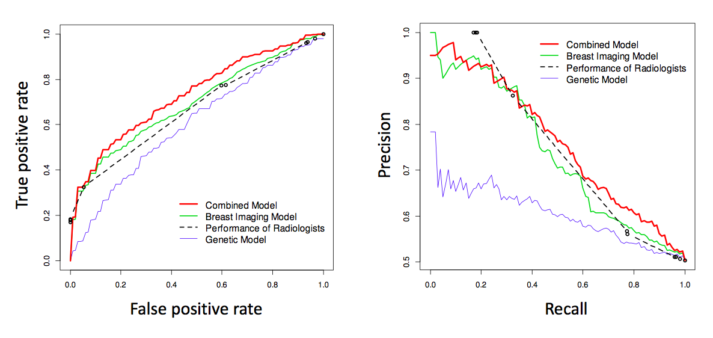
Diagnostic Mammograms with Genetics from GWAS
(Liu, Burnside et al., AMIA 2013, AMIA-TBI 2014)

Slide 31
ROC Curves for Random Forest Prediction of Atrial Fibrillation/Flutter & Subsequent Mortality or Stroke

Slide 32
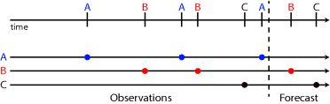
Timeline Representations
Continuous-time, discrete-state, with piecewise-constant transition rates
Point process: piecewise-continuous conditional intensity model (PCIM)
(Gunawardana et al., NIPS 2011)
Continuous-time Bayesian networks (CTBNs) (Nodelman et al, UAI 2002)
Model of Events
Point Processes
Model of Persistent State
CTBNs
Notes:
Ddx: GERD, angina, costochondritis, aortic dissection, pericarditis, pulmonary embolism, pneumothorax

Slide 33
Intensity Modeling
Event types l in L
Trajectory x: a sequence of time event pairs (t,l)_{i}
Rate function λ(t|h) for {PCIM: events, CTBN: transitions}

Slide 34
Intensity Modeling
Event types l in L
Trajectory x: a sequence of time event pairs (t,l)_{i}
Rate function λ(t|h) for {PCIM: events, CTBN: transitions}
Assumption: λ piece-wise constant
Dependency: {PCIM: basis states s in S, CTBN: variable states X}
states s in Σ_{l}, Σ_{l} mapping from x to S
e.g. PCIM: λ_{a} depends on event b in [t-1,t)
e.g. CTBN: λ_{a} depends on B=b

Slide 35

Intensity Modeling
Event types l in L
Trajectory x: a sequence of time event pairs (t,l)_{i}
Rate function λ(t|h) for {PCIM: events, CTBN: transitions}
Assumption: λ piece-wise constant
Dependency: {PCIM: basis states s in S, CTBN: variable states X}
states s in Σ_{l}, Σ_{l} mapping from x to S
e.g. PCIM: λ_{a} depends on event b in [t-1,t)
e.g. CTBN: λ_{a} depends on B=b
Likelihood:
M_{ls} : count of l given s
T_{ls} : cumulative duration until l given s

Slide 36
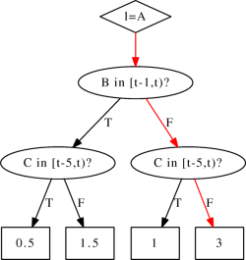
Point Process a.k.a., Piecewise-continuous Conditional Intensity Model (PCIM)
Represent dependencies with trees (Gunawardana et al, NIPS 2011)

Slide 37
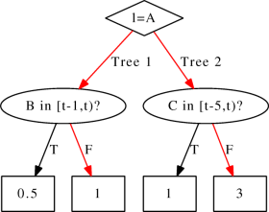
Multiplicative forests
Represent dependencies with trees forests

Slide 38
Multiplicative forests
Represent dependencies with trees forests
In CTBNs, multiplicative forests (Weiss et al, NIPS 2012):
Efficiently represent complex dependencies
Empirically require less data to learn
Are learned by maximizing change in log likelihood
Are learned neither in series or in parallel

Slide 39
Multiplicative forests
(Weiss et al., NIPS’12; ECML’13)
Represent dependencies with trees forests
In CTBNs, multiplicative forests (Weiss et al, NIPS 2012):
Efficiently represent complex dependencies
Empirically require less data to learn
Are learned by maximizing change in log likelihood
Are learned neither in series or in parallel
We can apply multiplicative forests
to point processes!

Slide 40
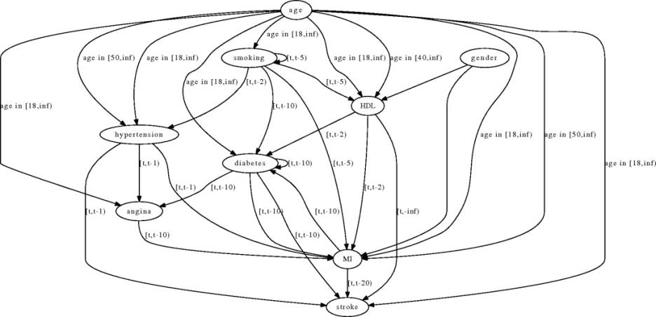
Example CTBN or PCIM Structure
1) Simulation
2) Electronic Health Records
Goal: recover network-dependent event rates – measured by test set log likelihood

Slide 41
Some Lessons So Far
Timeline modeling appropriate but further advances needed for whole EHR, missing data, computational efficiency
Once we have detailed clinical history, genetics helps predictive accuracy only a little, often not at all
  Genotype d-separated from target phenotype given years of other clinical phenotypes?
  Or do we need whole sequences, epigenetics, etc.
With a few carefully selected features, OLS or Logistic Regression often the best
Can usually do better by throwing in entire EHR/data warehouse
  Statistical relational learning naturally suited, works well
  Random forests are fast and about as good surprisingly often

Slide 42
Vision
Build predictive models for every ICD9 or 10 diagnosis, every CPT procedure, response to every drug, at press of a button.
  Not everything can be predicted accurately, but some can be
  Follow up on, and translate to the clinic, those that can be
Translate the most accurate models into the clinic, whether as lessons or decision support algorithms

Slide 43
Issues in Phenotyping
Explanatory Phenotyping (Peissig thesis, JBI 2013)
  Who really had a myocardial infarction (MI) and when?
  Patient was on different doses of Warfarin – what was the stable dose?
Predictive Phenotyping
  Who will have an MI in the next year?
  Who will have an MI in the next year if they take this drug?
  What will be the stable dose of Warfarin for this patient?
Causal Discovery
  How much will patient reduce risk of MI if he stops smoking?
  Was the MI caused by the drug? (Would patient have had MI anyway? As soon?)
  Is there some adverse drug event (ADE) being caused by this drug, and we don’t even know what it is?

Slide 44
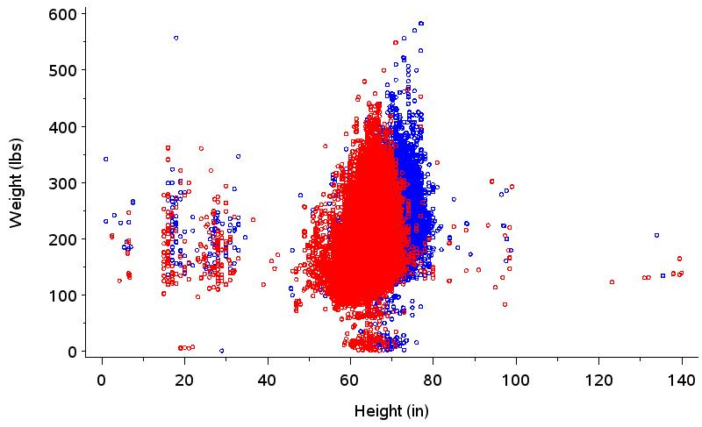
An example of “pristine” data:
Unfiltered EHR Adult Height/Weight
Introduction
Pancake
People
Giants
String beans

Slide 45
Example Rheumatoid Arthritis
Phenotyping Algorithm
ICD 9 codes (any of the below)
714 Rheumatoid arthritis and other inflammatory polyarthropathies
714.0 Rheumatoid arthritis
714.1 Felty’s syndrome
714.2 Other rheumatoid arthritis with visceral or systemic involvement
AND
Medications (any of the below)
  methotrexate [MTX][amethopterin] sulfasalazine [azulfidine]; Minocycline [minocin][solodyn]; hydroxychloroquine [Plaquenil]; adalimumab [Humira]; etanercept [Enbrel] infliximab [Remicade]; Gold [myochrysine]; azathioprine [Imuran]; rituximab [Rituxan] [MabThera]; anakinra [Kineret]; abatacept [Orencia]; leflunomide [Arava]
Introduction
AND
Keywords (any of the below)
  rheumatoid [rheum] [reumatoid] arthritis [arthritides] [arthriris] [arthristis] [arthritus] [arthrtis] [artritis]
eMERGE Network, www.gwas.org

Slide 46
Rheumatoid Arthritis Case : Exclusions
AND NOT
ICD 9 codes (any of the below)
714.30 Polyarticular juvenile rheumatoid arthritis, chronic or unspecified
714.31 Polyarticular juvenile rheumatoid arthritis, acute
714.32 Pauciarticular juvenile rheumatoid arthritis
714.33 Monoarticular juvenile rheumatoid arthritis
695.4 Lupus erythematosus
710.0 Systemic lupus erythematosus
373.34 Discoid lupus erythematosus of eyelid
710.2 Sjogren's disease
710.3 Dermatomyositis
710.4 Polymyositis
555 Regional enteritis
555.0 Regional enteritis of small intestine
555.1 Regional enteritis of large intestine
555.2 Regional enteritis of small/large intestine
555.9 Regional enteritis of unspecified site
564.1 Irritable Bowel Syndrome
135 Sarcoidosis
719.3 Palindromic rheumatism
719.30 Palindromic rheumatism, site unspecified
719.31 Palindromic rheumatism involving shoulder region
719.32 Palindromic rheumatism involving upper arm
719.33 Palindromic rheumatism involving forearm
719.34 Palindromic rheumatism involving hand
719.35 Palindromic rheumatism involving pelvic region and thigh
719.36 Palindromic rheumatism involving lower leg
719.37 Palindromic rheumatism involving ankle and foot
719.38 Palindromic rheumatism involving other specified sites
719.39 Palindromic rheumatism involving multiple sites
etc…
Introduction
OR
Keywords (any of the below)
juvenile [juv] rheumatoid [rheum] [reumatoid] [rhumatoid] arthritis [arthritides] [arthriris] [arthristis] [arthritus] [arthrtis] [artritis]
juvenile [juv] arthritis arthritis [arthritides] [arthriris] [arthristis] [arthritus] [arthrtis] [artritis]
juvenile chronic arthritis [arthritides] [arthriris] [arthristis] [arthritus] [arthrtis] [artritis]
juvenile [juv] RA; JRA
Inflammatory [inflamatory] [inflam] osteoarthritis [osteoarthrosis] [OA]
Reactive [psoriatic] arthritis [arthropathy] [arthritides] [arthriris] [arthristis] [arthritus] [arthrtis] [artritis]

Slide 47
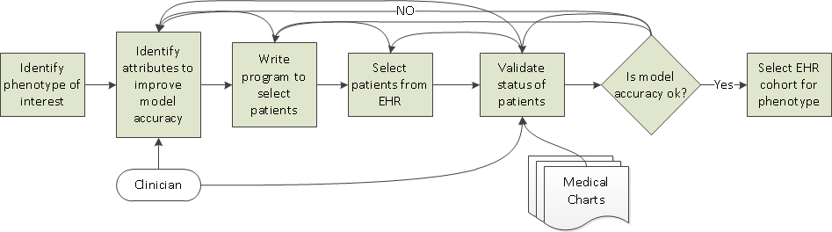
Manual EHR-Phenotyping Process
Effort

Slide 48
Challenges with Manual Process
Attributes are identified by domain experts
Diagnosis → Phenotype
Usually define attributes that are easy to see
Notes:
Computational discipline aimed at creating algorithms that allow computers to use large amounts of data to build predictive models or recognize complex patterns or characteristics within data.

Slide 49
Challenges with Manual Process
Attributes are identified by domain experts
They may miss attributes that are not obvious.
Medications
Diagnosis
Environment
Genetics
Phenotype
Vitals
Lab
Treatment
History
Observations
Notes:
Computational discipline aimed at creating algorithms that allow computers to use large amounts of data to build predictive models or recognize complex patterns or characteristics within data.

Slide 50
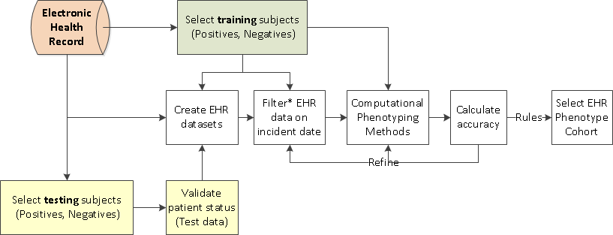
Descriptive (Retrospective) Phenotyping

Slide 51
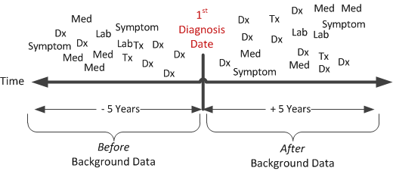
*Filtering for Descriptive Phenotyping
Identify Attributes

Slide 52
Challenges with Retrospective Phenotyping
Can we automate this process?
How to select POS/NEG with minimal effort?
What is optimal # POS to develop model?
Can computational methods be improved?
How to deal with longitudinal, missing and sparse data issues?
Can probabilities be assigned to indicate risk/likelihood of being a phenotype?

Slide 53
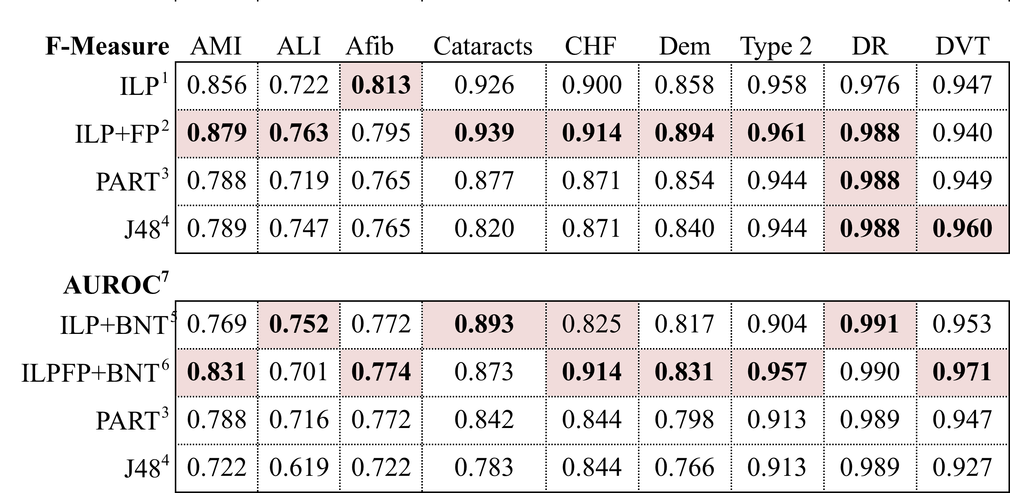
Phenotype Specific Results

Slide 54
Issues in Phenotyping
Explanatory Phenotyping
  Who really had a myocardial infarction (MI) and when?
  Patient was on different doses of Warfarin – what was the stable dose?
Predictive Phenotyping
  Who will have an MI in the next year?
  Who will have an MI in the next year if they take this drug?
  What will be the stable dose of Warfarin for this patient?
Causal Discovery
  How much will patient reduce risk of MI if he stops smoking?
  Was the MI caused by the drug? (Would patient have had MI anyway? As soon?)
  Is there some adverse drug event (ADE) being caused by this drug, and we don’t even know what it is?

Slide 55
Adverse Drug Events (ADEs)
In U.S. 10% to 30% of hospital admissions are owing to ADEs
Cost $30B to $150B per year
Congress passed law 6 years ago requiring FDA to do post-marketing surveillance
FDA, FNIH and PhARMA formed Observational Medical Outcomes Partnership for data and methods
Work continuing under OHDSI and IMEDS within Reagan-Udall

Slide 56
Two Very Different ADE Tasks
Given: an EHR and a known ADE (a <drug,condition> pair)
Do: learn model to predict (at prescription time) whether a patient will have the ADE if they take the drug
Given: an EHR and a specified drug
Do: find conditions caused by the drug (ADE)
Notes:
For first task, accurate prediction is all we care about, but for second we really want CAUSALITY. Second is the task we will focus on today.

Slide 57
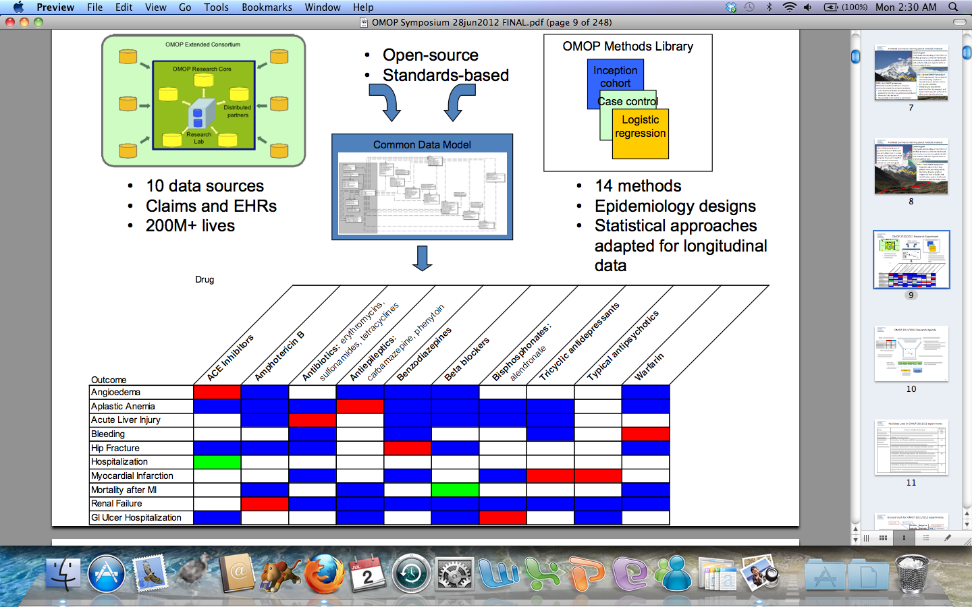
Observational Medical Outcomes Partnership 2011

Slide 58




Current Approaches
Warfarin
Heart Attack
Cox2 inhibitor
Angioedema
…
…
ACE inhibitor
Bleeding

Slide 59
Many Methods from Epidemiology
Propensity scoring: do drug and condition appear together more than one would expect by chance from their individual frequencies?
  Might count patients or occurrences
  Might limit co-occurrence by exposure eras
Self-controlled studies: use patients as own control, before vs. after drug exposure
Notes:
Propensity: confusion matrix or 2X2 contingency table… many variations in details.

Slide 60
Existing Methods’ Limitations
Candidate conditions must be pre-specified (though might be many)
No consideration of context – ADE might only arise when patient
  is taking another drug (drug interaction)
  has specific properties, such as low weight or specific genetic variation

Slide 61
Current Approaches
Warfarin
Heart Attack
Cox2 inhibitor
Angioedema
…
…
ACE inhibitor
Bleeding

Slide 62
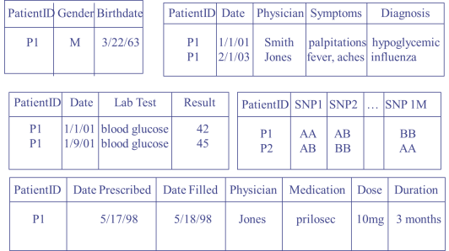
What We Would Like:
Cox2 inhibitor(P,D)
hypertension(P)
Warfarin
older(P,55)
, vioxx(D)
Cox2 inhibitor
…
ACE inhibitor
EMR
Notes:
Don’t want pre-defined list of events – too much bias in approach limits discoveries
Problem is supervision – only supervision we can give is who is on drug, not who has event, since we haven’t defined the event

Slide 63
Reverse Machine Learning
We already know who is on drug, and we want to find the condition it causes
But we don’t know which condition
  Might not even have predicate for condition in our vocabulary
  Assume only that we can build condition definition from vocabulary as a clause body
Treat drug use as target concept, and learn to predict that based on events after drug initiation

Slide 64
Use Relational Learning Approach from Earlier, but with Temporally-aware Scoring
If enzyme_inducer(P) and bleeding(P) then warfarin(P)
If vkorc1_snp(P,tt) and bleeding(P) then warfarin(P)

Slide 65
Why Temporally-aware Scoring?
Positive Examples: patients on drug (data after drug initiation)
Negative Examples: patients not on drug
Standard correlation-based scoring from earlier
Results Poor
  1 body literal: OMOP AUCROC only 0.51!
  More literals: found mostly drug indications

Slide 66
Approach
Search for events that occur more frequently after drug initiation than before
Basic scoring function:
P(t_{c} > t_{d} | c,d)
Normalize by dividing by:
P(t_{C} > t_{d} | C,d) P(t_{c} > t_{D} | c,D)
Notes:
Learn a lesson from the epidemiologists about self-controlled studies – entire focus is on TIME, throw out correlation all together!

Slide 67
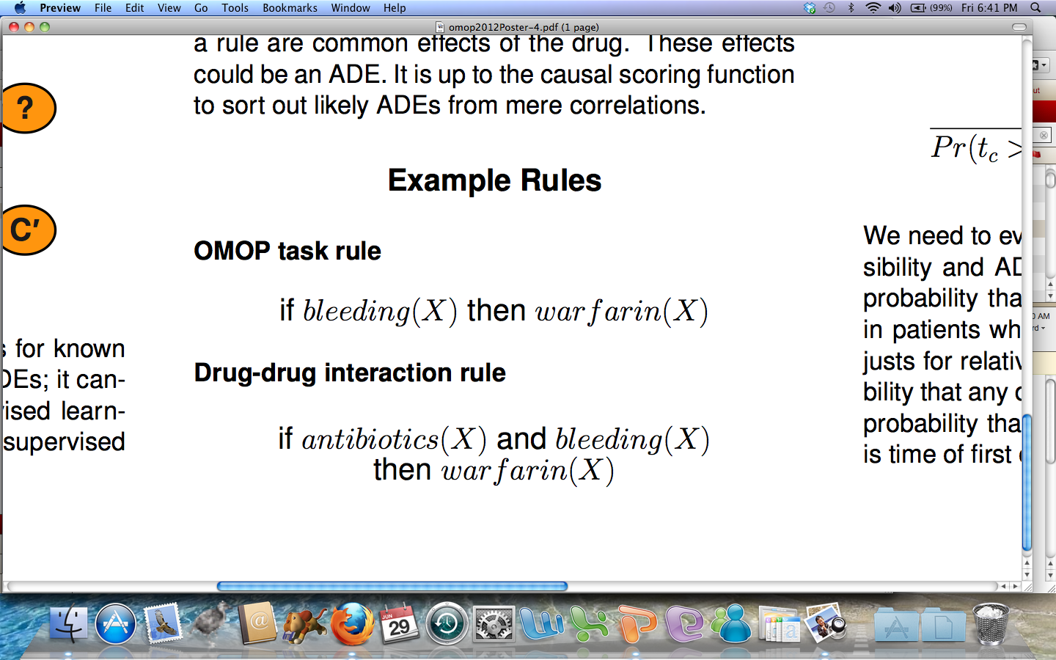

Slide 68
Cox2 Rules
Found myocardial infarction (MI, or heart attack) association, and could have found it just two years into use
Found the Vioxx-specific rule for increased blood pressure in older people
Other rules just associated with reason for taking drug (indications)
Some false ADEs score higher than true ADEs because of confounding

Slide 69
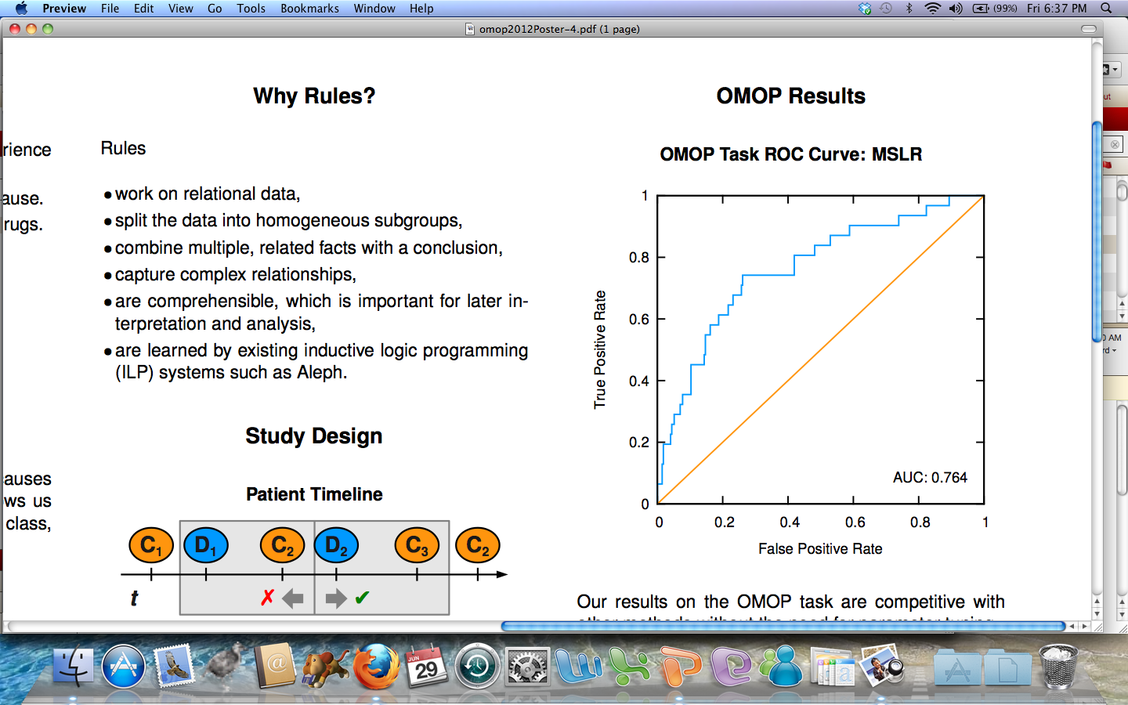
Notes:
This is very hard problem. Evidence now that some of the negative examples are really positive! Some drugs had only a few patients, some events extremely rare.

Slide 70
Why Not Better? Confounders
Use graphical models. Could use DBNs but temporal data is very irregularly sampled
Learn CTBNs or PCIMs
Learn pairwise Markov network (Aubrey Barnard’s work)
  Nodes are drugs and diseases
  Potential on an edge represents probability of one preceding the other
  Represent as log-linear model with precedes features

Slide 71
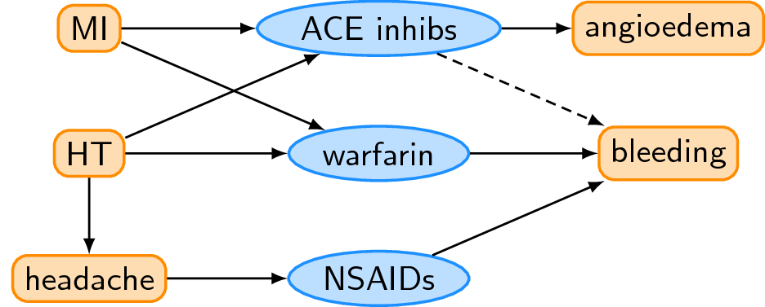
Small Markov Network Example

Slide 72
Results on OMOP Data Sets

Slide 73
Other Challenges to Precision Medicine
Can get better results with more data, more diversity, more ML researchers with data access, but…
Privacy is huge hindrance to data sharing
GWAS have mostly underwhelmed… can we do better with specialized ML approaches taking into account correlations among SNPs, working with whole sequence data, etc.?

Slide 74
Applying Differential Privacy to IWPC Data
(Fredrikson, Lantz, Jha, Lin, Page, Ristenpart; USENIX Security ’14)

Slide 75
MRF for Multiple Comparisons Problem in GWAS
(Liu, Zhang, Burnside, Page; ICML’14; UAI’12)

Slide 76
Conclusion
Precision Medicine Holds Great Promise, and a lot is being expected of all of US HERE NOW
We’re computer scientists… let’s automate as much as possible
Use failures, less-than-perfect results, practical challenges to drive development of our new advances

Slide 77
Thanks!
NLM, NIGMS, NIH BD2K
International Warfarin Pharmacogenetics Consortium (IWPC)
Wisconsin Genomics Initiative (WGI)
Aubrey Barnard
Kendrick Boyd
Elizabeth Burnside
Michael Caldwell
Jesse Davis
Eric Lantz
Jie Liu
Peggy Peissig
Vitor Santos Costa
Jude Shavlik
Humberto Vidaillet
Jeremy Weiss

