Slide 1


Clustering Heterogeneous Samples During Model Selection
Kathleen Gates, Ph.D.
Assistant Professor
L.L. Thurstone Psychometric Lab
Department of Psychology

Slide 2



Research Group
Stephanie Lane, M.A.
Teague Henry, B.S.
Zachary Fisher, M.S.

Slide 3
Main Points
“Heterogeneous sample”: individuals within the sample vary in their temporal processes.
This occurs often in functional MRI studies, and presents a problem for modeling
Group Iterative Multiple Model Estimation (GIMME) provides a solution that arrives at group, subgroup, and individual-level models.

Slide 4
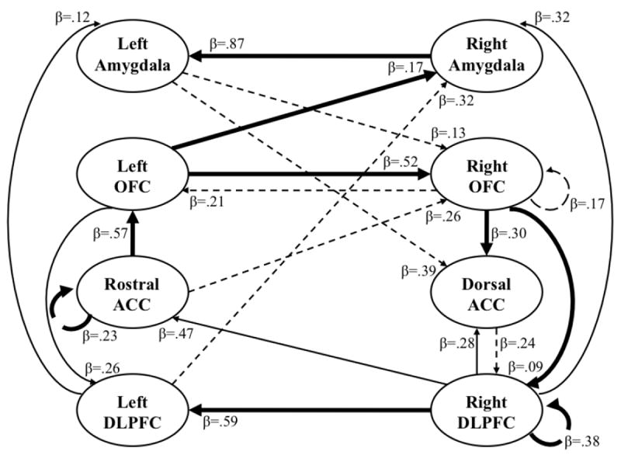
An Individual Differing from the Group
Legend:
Contemporaneous
Lag
Thick lines indicate group- level paths
Belttz et al., 2014
Notes:
To transition to next slide: oftentimes researchers are interested in comparing subgroups.

Slide 5
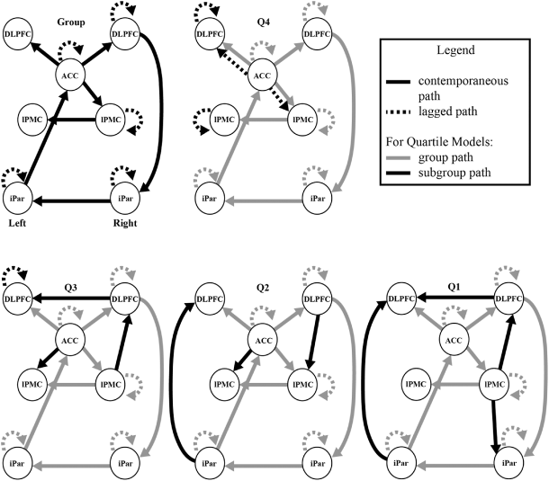
Differences in Brain Processes According to Subgroups Based on Performance
Nichols, et al., 2014

Slide 6
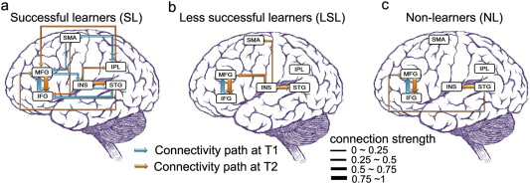
Differences in Brain Processes According to Subgroups Based on Learning
Yang, Gates, Molenaar, & Li, 2015

Slide 7
Problem: We don’t always know the best “subgroup” for individuals
Biologically, some individuals may be more similar to individuals that are in a different subgroup than the one in which they were arbitrarily placed.
There is often heterogeneity within groups (such as ADHD or ASD diagnoses; Fair et al., 2013; Volkmar et al., 2011), suggesting there may be subgroups within these populations.

Slide 8
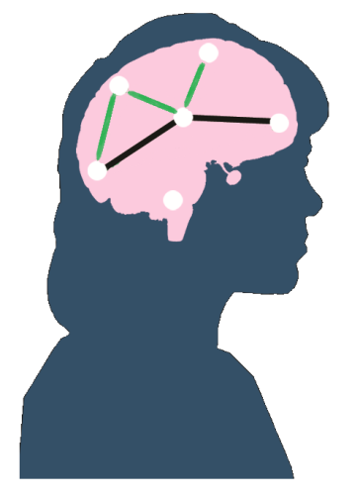
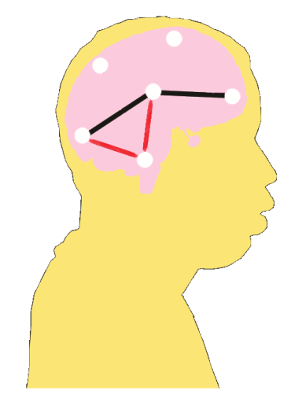
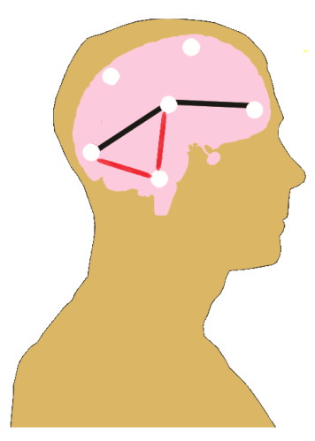
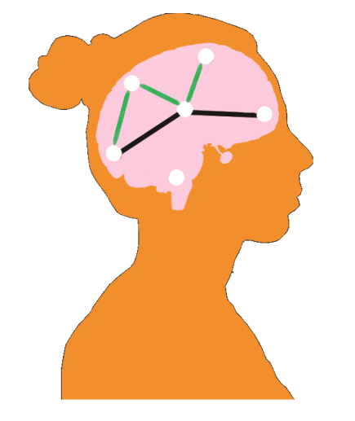
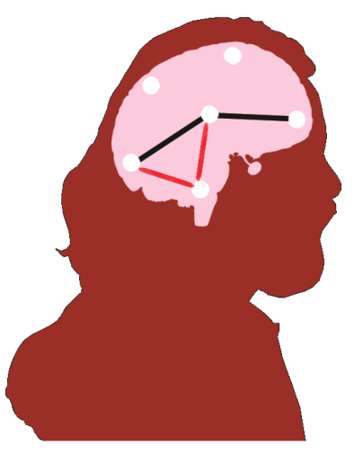
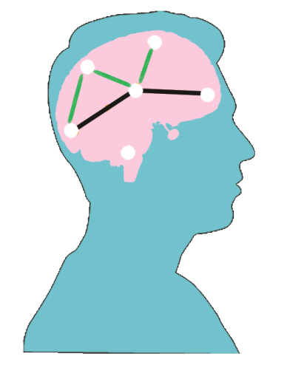
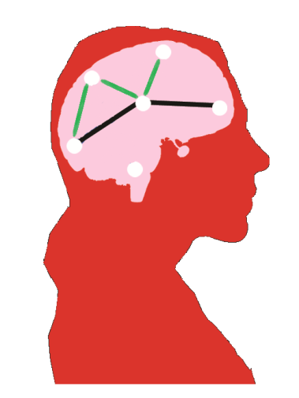
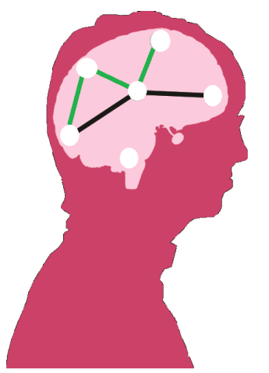
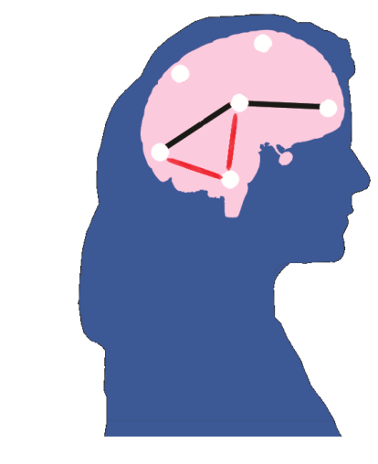
Conceptualizing Subgrouping Individuals Based on Temporal Processes
ASD Subgroup B
Typically Developing Controls
Male
ADHD
Typically Developing Controls
Female
ASD
ASD SubgroupA
Notes:
We take the individual-level estimates of beta maps and arrive at communities (or groups) of people that are based on their brain maps as opposed to by their diagnostic or demographic categories
Difficutl to tell, need data-driven.
Individuals will be subgrouped in the following manner: the introduction on individual-level paths allow for unbiased estimates of beta values. We correlate each indivduals beta values

Slide 9
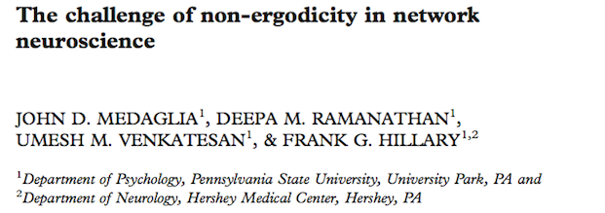
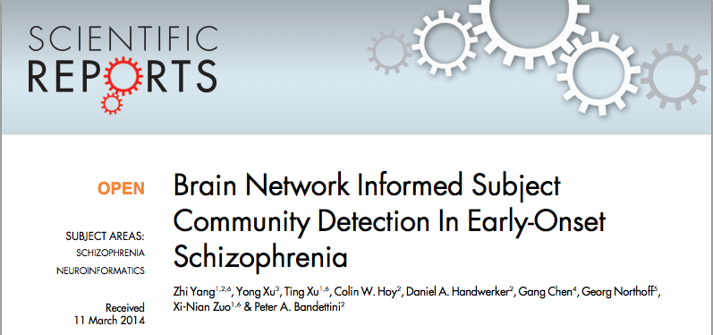



The Problem of Heterogeneity is Increasingly Being Acknowledged

Slide 10
How could identifying subgroups in a data-driven manner be helpful?
Subgrouping individuals according to their brain processes is complementary to using arbitrarily predefined groups and thus can be a validity check.
Researchers could identify biological underpinnings related to specific behaviors within a heterogeneous sample.
Notes:
To transition to next: before subgrouping on brain processes, we need to be able to arrive at reliable individual-level models. So please keep in mind that our end-goal is to subgroup, but we need to take a little detour into how to get reliable individual-level maps

Slide 11
Unified SEM* as a method for quantifying “brain processes”
*this is also called Structural Vector Autoregression (SVAR)
Left
Prefrontal
Cortex
Right
Prefrontal
Cortex
Legend
Contemporaneous (A)
Lag (Φ)
Amygdala
  η(t) = Aη(t) + Φ₁η(t-1) + ζ(t)
  η(t) are observed time series data; ζ(t) are errors
Chow et al., 2011; Hamaker et al., 2007;
Gates et al., 2010; Kim et al., 2007
Notes:
In order to subgroup, we must first be able to arrive at individual-level models describing the temporal processes. So we’ll take a little detour and look into an approach that can reliably obtain individual-level paths
To transition to next: this model can be applied at the group or individual level; problems arise with both.

Slide 12
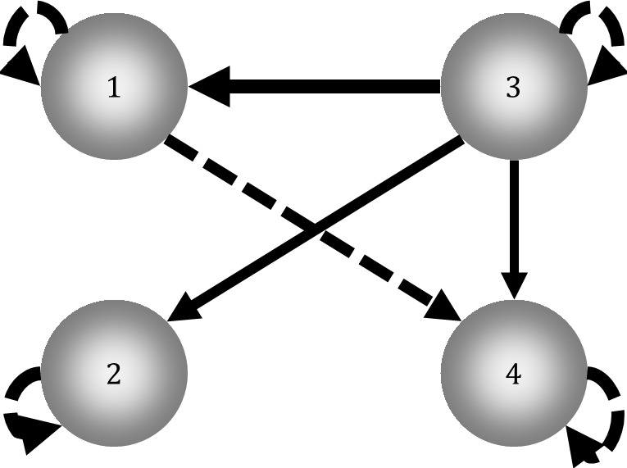
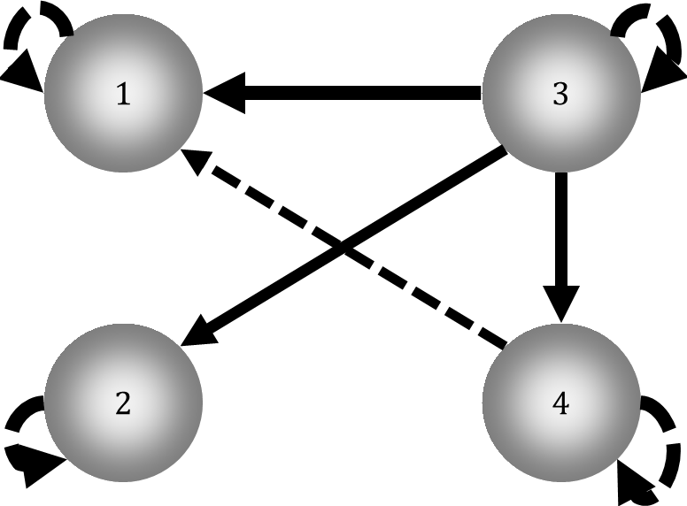
False Positives May Result When Homogeneity Assumption Violated
Participant 1
Participant 2
1
3
Participant 3
2
4
Legend:
Contemp. ROI Effects Negative
Lagged ROI Effects False Positive

Slide 13
Standard Methods are Unable to Identify Directed Relations at the Individual Level
Smith et al. (2011) Tested 38 connectivity methods on 28 sets of simulated data
None of the methods tested could recover the presence of a path and the directionality:
Unified SEM also couldn’t recover the direction, nor could LiNGAM, GES, or PC.
ROI6
ROI10
ROI7
ROI1
ROI9
ROI8
ROI5
ROI2
ROI4
ROI3
Smith et al., 2011

Slide 14
Follow-up work revealed some insights
At least two sets of approaches that utilize some information from the sample can recover the presence and direction of effects:
  LiNGAM-inspired procedures (Ramsey, Hanson, & Glymour, 2011; Ramsey, Sanchez-Romero, & Glymour, 2013).
  Group Iterative Multiple Model Estimation (GIMME; Gates & Molenaar, 2012).
ROI6
ROI10
ROI7
ROI1
ROI9
ROI8
ROI5
ROI2
ROI4
ROI3

Slide 15
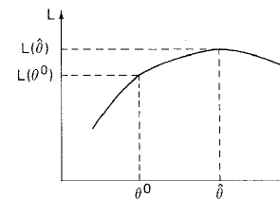
Model Selection Using Modification Indices (Lagrange Multiplier Test Equivalents)
Modification Indices (MIs) indicate the expected change in likelihood from the null hypothesis to the alternative for each candidate parameter.
(Log Likelihood)
(Null)
(Parameter Freed)
Engle, 1984; Gates et al., 2010; Sorbom, 1987
Notes:
If LM is high, the hypothesis that the model with the extra parameter equals the null may be rejected
Lagrange Multiplier (LM) equivalent identifies which parameter, if freed, would maximally improve model fit.

Slide 16
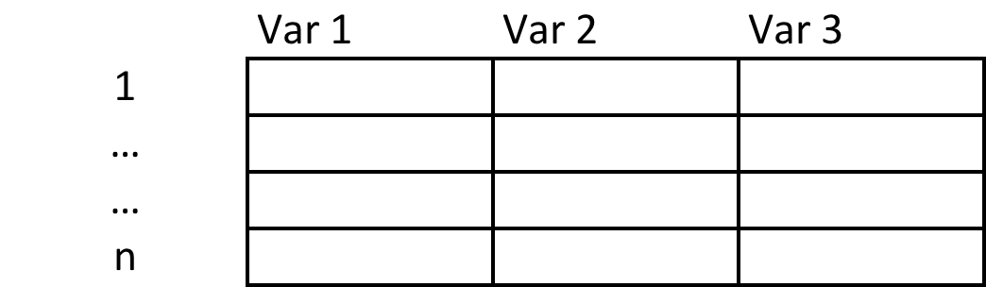
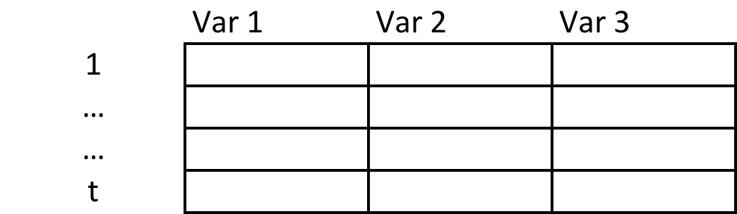
Time Series Data Provides Multiple Samples of Individual Processes
Sample 4
n = total number of individuals
Sample 3
Sample 2
Sample 1
Sample n (i=n)
t = total number of time points
Sample 3 (i=3)
Sample 2 (i=2)
Sample 1 (i=1)

Slide 17
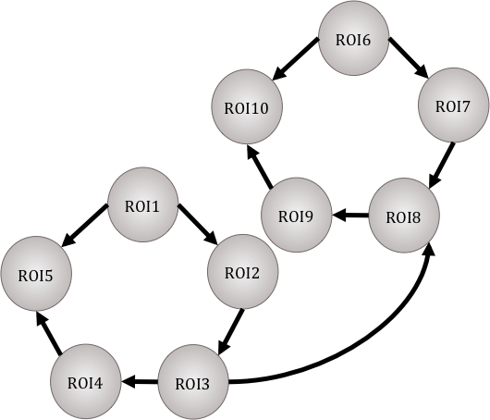
Subgrouping within Group Iterative Multiple Model Estimation (GIMME)
ROI6
ROI6
Arrive at group-level model using modification indices in a way that only selects paths that improve the majority of individual models.
Conduct model search for individual-level paths and arrive at individual-level estimates.
ROI7
ROI10
ROI7
ROI10
ROI1
ROI1
ROI9
ROI9
ROI8
ROI8
ROI2
ROI5
ROI2
ROI5
Person A
Person B
17/18
ROI4
ROI4
ROI3
ROI3
Gates & Molenaar, 2012
Notes:
Indicate here that we know from previous work that starting with the group prior improves recovery of individual-level paths.

Slide 18
Group Iterative Multiple Model Estimation (GIMME) Reliably Recovers the Existence and Direction of Paths at Group and Individual Levels
ROI6
ROI10
ROI7
Found 100% of connections
Correctly identified directionality 90% of the time
Can also detect connections which exist on the individual level
ROI1
ROI9
ROI8
ROI5
ROI2
ROI4
ROI3
Gates & Molenaar, 2012
Notes:
Tlak about correlation, this is as good as that,
But gain directionality

Slide 19
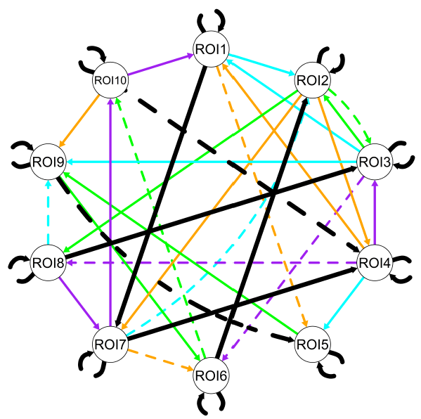
Simulated Data: 4 Subgroups and 2 Random Paths Added for Each Individual (not shown)
Simulated Data Across 3 Factors:
Number of individuals (N=25, 100, 200)
Number of subgroups (2, 3, and 4)
Degree of Heterogeneity (equal groups, one group comprising 50% of sample)
Gates, Lane, & Henry, in progress
Notes:
In previous work presented earlier in the slide, we saw 2-7 paths opened up at the subgroup-level

Slide 20
Simulated Data: 4 Subgroups and 2 Random Paths Added for Each Individual (not shown)
GIMME Results:
Recovered 92% (sd: 4%) of true paths
Of those recovered, 88% (sd: 4%) of paths had the correct direction
Gates, Lane, & Henry, in progress
Notes:
(Precision = 88%, sd.=5%)
(direction Precision = 82%, sd.=5%)

Slide 21
GIMME Recovers paths even when the majority are individual-level
Results:
GIMME Correctly recovered 100% of connections with 94% correct direction across all individuals.
Individual-level approach recovered only 83%
LPFC
RPFC
Legend
Group (100%)
Exp. Stimuli Bilinear Temp.
Individual
LPar
RPar
Vis.
Gates & Molenaar, 2012
Notes:
Point out that having some group paths as a prior greatly improves the individual-level path recovery.

Slide 22
Subgrouping Individuals Based on Temporal Processes
ASD
ASD Subgroup B
ASD SubgroupA
Typically Developing Controls
Notes:
We take the individual-level estimates of beta maps and arrive at communities (or groups) of people that are based on their brain maps as opposed to by their diagnostic or demographic categories
Difficutl to tell, need data-driven.
Individuals will be subgrouped in the following manner: the introduction on individual-level paths allow for unbiased estimates of beta values. We correlate each indivduals beta values

Slide 23
ROI1
ROI1
ROI1
ROI1
ROI2
ROI2
ROI2
ROI5
ROI2
ROI5
ROI5
ROI5
ROI4
ROI4
ROI4
ROI4
ROI3
ROI3
ROI3
ROI3
Notes:
There may be some individuals who share some of these aspects.
to get the NxN Aij matrix from previous slide.

Slide 24
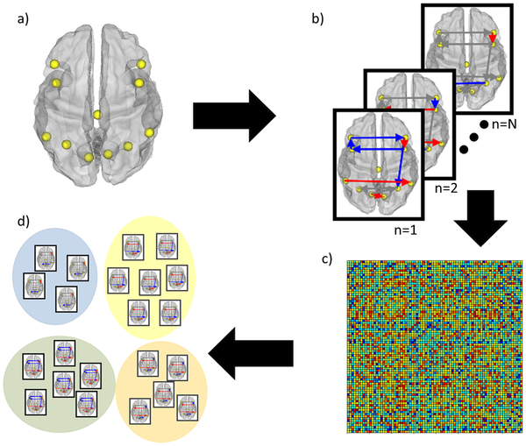
Schema of Analytic Process for Subgrouping After GIMME
Gates, Molenaar, Iyer, Nigg, & Fair, 2014

Slide 25
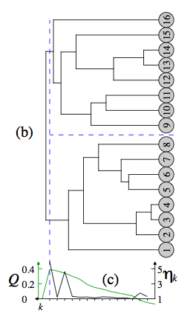
Modularity
A metric used to identify when the optimal partitioning of nodes is reached (Newman, 2006)
In this example, the highest modularity corresponded to a two-group solution.
Image taken from Pons & Latapy, 2005

Slide 26
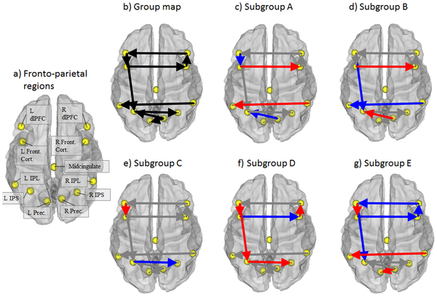
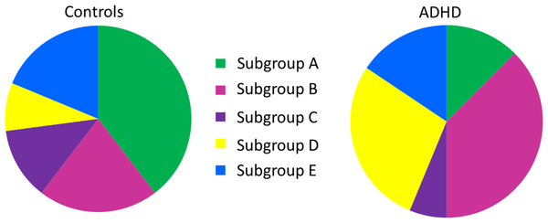
Heterogeneity Found Within Typically Developing Control and ADHD Children
Gates, Molenaar, Iyer, Nigg, & Fair, 2014
Notes:
To transition to next slide – say that the correlation matrix was dichotomized, and we wanted to use a weighted comm detection algorithm

Slide 27
A Comparison of Community Detection Algorithms on Correlation Matrices (Red): Walktrap Outperforms
Gates, Henry, Steinley, & Fair, In Progress

Slide 28
Subgrouping within Group Iterative Multiple Model Estimation (GIMME)
ROI6
ROI6
ROI6
Arrive at group-level model using modification indices in a way that
only selects paths that improve
the majority of individual models.
Conduct community detection on the similarity matrix representing dyad-level similarity in brain processes to subgroup individuals.
Arrive at subgroup-level model using same criteria as in step 1.
Conduct model search for individual-level paths and arrive at individual-level estimates.
ROI7
ROI7
ROI10
ROI7
ROI10
ROI10
ROI1
ROI1
ROI1
ROI9
ROI9
ROI8
ROI9
ROI8
ROI8
ROI2
ROI2
ROI5
ROI2
ROI5
ROI5
ROI4
ROI4
ROI3
ROI4
ROI3
ROI3
Notes:
Indicate here that we know from previous work that starting with the group prior improves recovery of individual-level paths.
Add that we could subgroup using correlation matrixes to arrive at the similarity matrix
To transition to next slide – say that now that we have the best algorithm, we need to decide the best features upon which to cluster

Slide 29
Two Benefits of Clustering During Model Selection
Can better tease out signal from noise because group-level similarities are removed.
Individual-level paths with be even more reliable if subgroup-level paths are considered.

Slide 30
Formal Specification: uSEM Estimated with subgrouping GIMME
ROI6
Legend
Contemporaneous (A) Lag (Φ)
Subgroup B
Individual-level
ROI10
ROI7
ROI1
ROI9
ROI8
ROI5
ROI2
ROI4
ROI3
Gates, Lane, & Henry, in progress
Notes:
Beta weights

Slide 31
Simulated Data: 4 Subgroups and 2 Random Paths Added for Each Individual (not shown)
Simulated Data Across 3 Factors:
Number of individuals (N=25, 100, 200)
Number of subgroups (2, 3, and 4)
Degree of Heterogeneity (equal groups, one group comprising 50% of sample)
Gates, Lane, & Henry, in progress
Notes:
In previous work presented earlier in the slide, we saw 2-7 paths opened up at the subgroup-level

Slide 32
Simulated Data: 4 Subgroups and 2 Random Paths Added for Each Individual (not shown)
Subgrouping GIMME Results:
Recovered 93% (sd: 5%) of true paths
Recovered 90% (sd: 5%) of the true directions
Recovered subgroups appropriately across conditions (Average ARI_{HA}=.91)
Gates, Lane, & Henry, in progress
Notes:
(Precision = 97%, sd.=4%)
Direction (Precision = 93%, sd.=4%)

Slide 33
Clustering during model selection (“MI-Based”) outperformed clustering using correlation matrix:
As sample became more heterogeneous (i.e., more subgroups)
As sample size decreased
When subgroup sizes were disproportionate
Gates, Lane, & Henry, in progress

Slide 34
Empirical Data Example:
Autism Brain Imaging Data Exchange (ABIDE)
NYU Data
N=73 Autism Spectrum Disorder (ASD) diagnosed Individuals
Average Age: 14.6 (sd: 7.0)
87% Male
Data Acquisition: FoV read = 256 mm; TR = 2530 msec; TE=3.25 msec;
Craddock, James, Holtzheimer, Hux & Mayberg, 2012; Di Martino et al., 2012
Notes:
CPAC pipeline; Friston’s 24 parameter motion correction

Slide 35
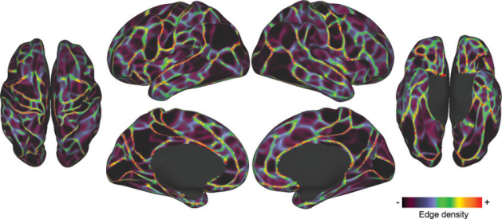
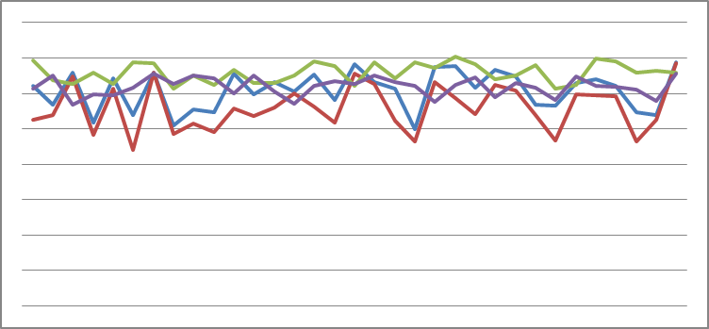
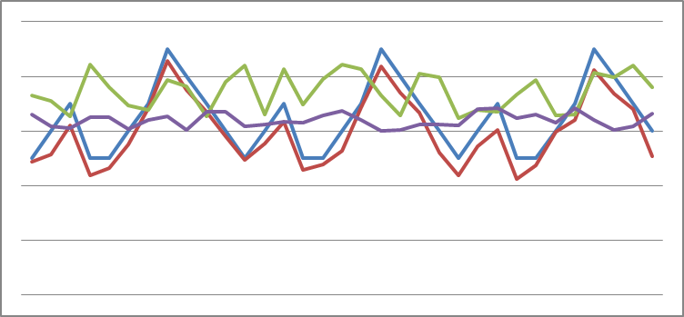
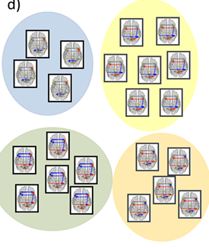
Data Pipeline
(b) Extract time series for each region for each individual (CPAC pipeline)
(a) Parcellate brain into DMN regions
Individual #N
Individual #2
Individual #1
(d) Obtain results: group-, subgroup-, individual-level models; individual-level estimates; subgroups.
(c) Run S-GIMME using extracted time series for all individuals

Slide 36
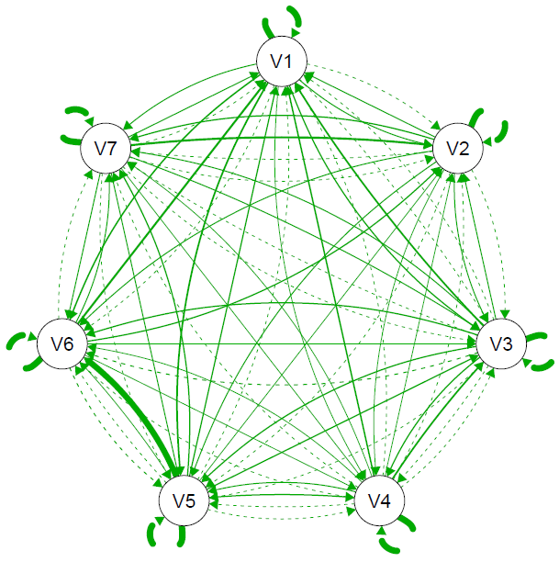
ABIDE Connectivity Map Results
Across All Individuals
RIPL
vACC
dmPFC
precun
LIPL
PCC
LMFG
Richey, Lane, Gates, Valdespino, Di Martino, & Müller, in progress

Slide 37
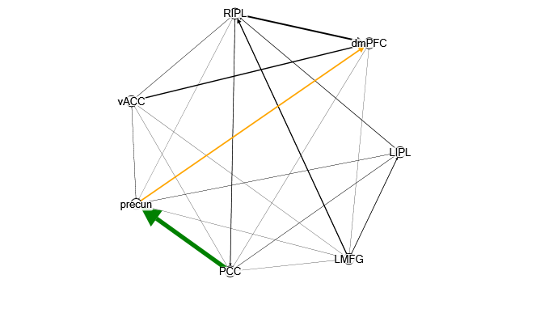
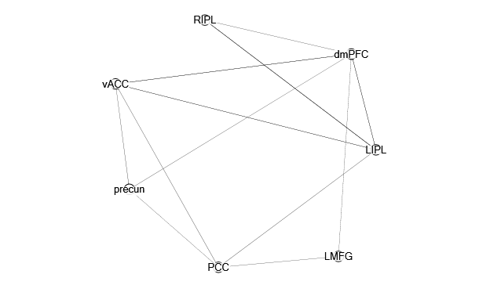
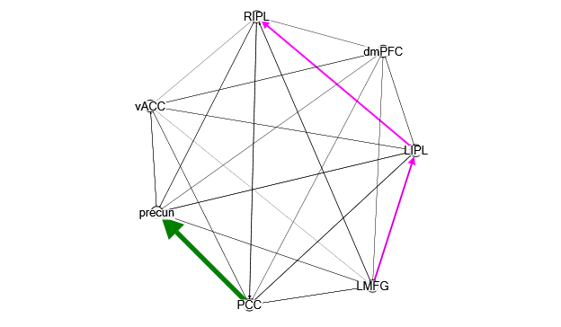
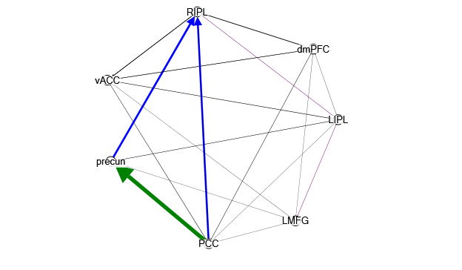
Subgroup Results
Subgroup A (N=19)
Subgroup B (N=7)
Subgroup C (N=36)
Subgroup D (N=11)
Richey, Lane, Gates, Valdespino, Dimartino, & Müller, in progress

Slide 38
Vineland Adaptive Social Behavior Scales
Often used to assess functioning level for developmentally delayed individuals
Three Domains:
  Communication (Receptive; Expressive; Written)
  Daily Living Skills (Personal; Domestic; Community)
  Socialization (Interpersonal Relations; Play and Leisure Time; Coping)
Sparrow, Cicchetti, & Balla, 1989

Slide 39
Multinomial Regression Results
Chi-Square change from null: 18.48, df=6, p=.005
Subgroup A (N=19)
Lower “Daily skills: Personal”
Higher “Socialization: Play and Leisure time”
Subgroup B (N=7)
“Loner” group.
Fewer paths per person than seen in other groups (lower degree).
Not related to VABS measures.
Subgroup D (N=11)
Higher “Socialization: Play and Leisure time”
Subgroup C (N=36) Reference Group
Richey, Lane, Gates, Valdespino, Di Martino, & Müller, in progress

Slide 40
Guiding Principals for Using GIMME
Arriving at paths:
  Improved reliable recovery seen with as few as 10 individuals in a sample
  Make sure variables are not highly correlated
Arriving at subgroups:
  Subgroups are reliably obtained when there are at least 25 individuals
Data-driven searches:
  Not a replacement for hypotheses, but helpful if the state of the science prevents arriving at informed hypotheses
Gates, Lane, & Henry, In Prep; Gates & Molenaar, 2012

Slide 41
Conclusions
ROI1
ROI1
ROI1
GIMME provides data-driven models of temporal relations across time using modification indices to guide model selection.
Reliable detection of path structure (i.e., temporal relations) are obtained at the group, subgroup, and individual levels with the forthcoming subgrouping feature in gimme.
During model-selection, individuals are placed into subgroups with others with similar brain processes, and this can reveal new insights.
ROI2
ROI2
ROI5
ROI2
ROI5
ROI5
ROI4
ROI4
ROI3
ROI4
ROI3
ROI3

Slide 42
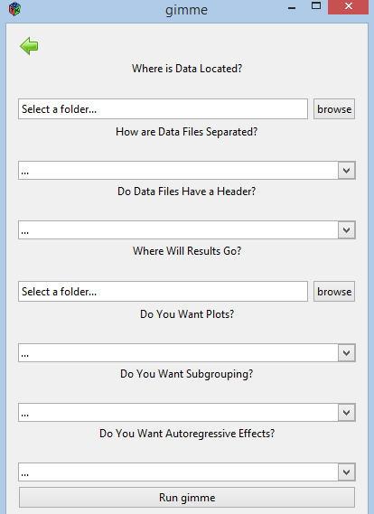
gimme is now a package available on CRAN.
GUI and Subgrouping features are forthcoming.
http://cran.r-project.org/web/packages/gimme/index.html

Slide 43



Acknowledgements
Peter Molenaar
Penn State
John Richey
Virginia Tech
Damien Fair
OHSU
Consulting on the ABIDE project:
Adriana Di Martino, Ph.D. (NYU)
Ralph-Axel Müller, Ph.D. (SDSU)
Clark Glymour, Ph.D. (Carnegie Melon)
Joe Ramsey, Ph.D. (Carnegie Melon)
Siwei Liu, Ph.D. (UC- Davis)
Daniele Marinazzo, Ph.D. (Ghent University)
Jing Yang, Ph.D. (Guangdong University)
Adriene Beltz, Ph.D. (Penn State)
Dan Elbich, M.A. (Penn State)
Suzy Scherf, Ph.D. (Penn State)
Steve Wilson , Ph.D. (Penn State)
Michael Hallquist, Ph.D. (University of Pitt)
Aidan Wright, Ph.D. (University of Pitt)
Doug Steinley, Ph.D. (University of Missouri)
Mariya Schiyko, Ph.D. (Northeastern)
Charlotte Boettiger, Ph.D. (UNC)
Laura Castro-Schilo, Ph.D. (UNC)
Stacey Daughters, Ph.D. (UNC)
Kelly Giovenello, Ph.D. (UNC)
Kevin Guiskewicz, Ph.D. (UNC)
Joseph Hopfinger, Ph.D. (UNC)
Wei Li, Ph.D. (UNC)
Kristen Lindquist, Ph.D. (UNC)
Peter Mucha, Ph.D. (UNC)
Thurstone Psychometric Lab (UNC)
This work has been supported by NIH/NIBIB Grant R21 EB015573-01A1
PI: Kathleen M. Gates - gateskm@email.unc.edu
gateslab.web.unc.edu

Slide 44
Modularity
A metric used to identify when the optimal partitioning of nodes is reached
Q = (fraction of edges within communities) – (expected fraction of such edges)
P_{ij} is the probability that individuals ‘i’ and ‘j’ are connected
m = total number of edges in network
δ(g_{i},g_{j}) is ‘1’ if individuals ‘i’ and ‘j’ are in the same subgroup, ‘0’ if not
Leicht & Newman, 2008; Newman, 2006
Notes:
% Note: Ci and Q may vary from run to run, due to heuristics in the
% algorithm. Consequently, it may be worth to compare multiple runs.
% Also see Good et al. (2010) Phys. Rev. E 81:046106.
%
% Reference: Leicht and Newman (2008) Phys Rev Lett 100:118703.
Large Q values indicate more edges than expected by chance
Ki kj/2m = probability of an edge btwn two vertices
Maximizes Q over all possible divisions of the network

