Slide 1
Source: xkcd

Slide 2
The Case for Empirical Evaluation of Methods for Causal Modeling
David Jensen College of Information & Computer Sciences Computational Social Science Institute University of Massachusetts Amherst
15 February 2018 Center for Causal Discovery University of Pittsburgh
This work is licensed under a Creative Commons Attribution-NonCommercial 3.0 Unported License.

Slide 3
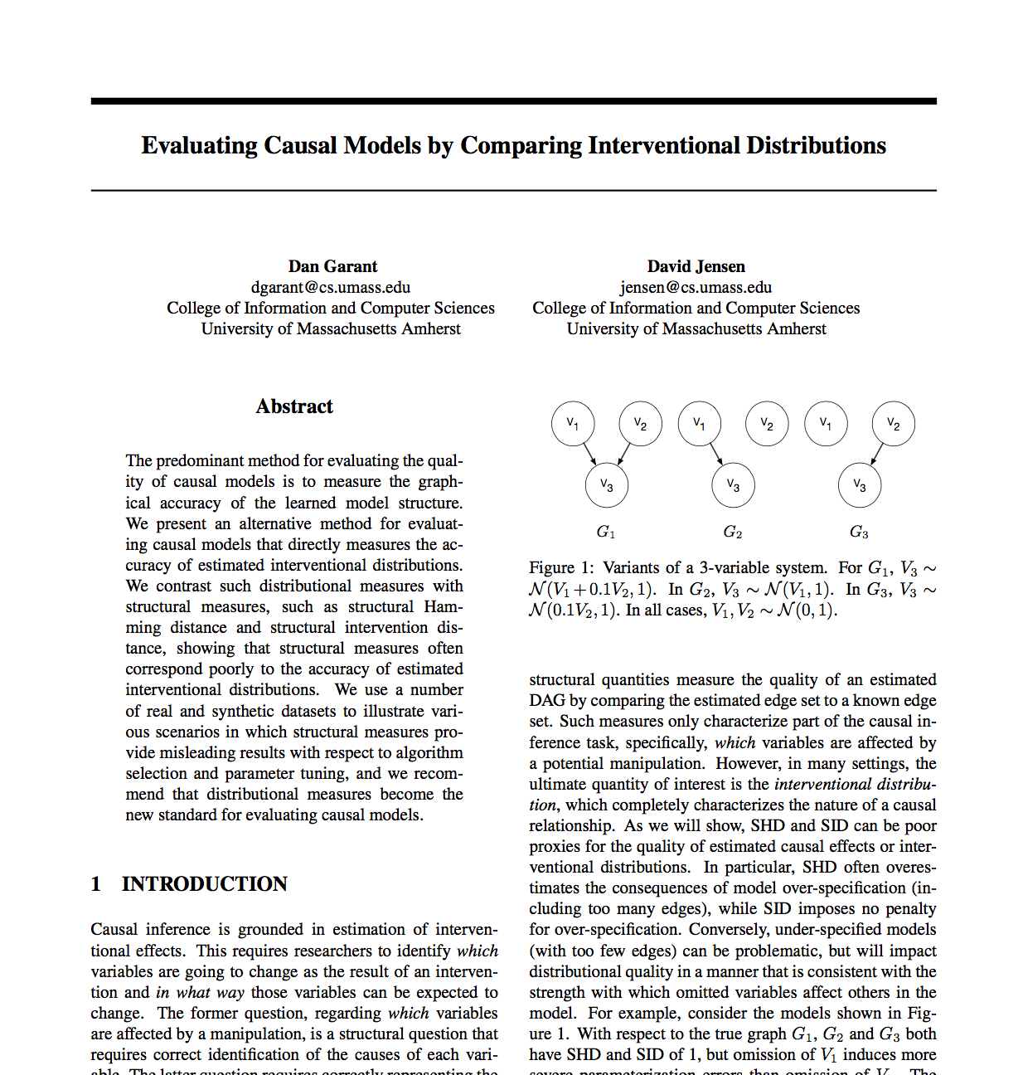

Slide 4
The idea
“Our understanding of causal inference, and the impact of practical techniques for causal modeling, would substantially improve if we more regularly conducted empirical evaluation of our practical techniques.”

Slide 5
The idea
“Specifically, we should apply a broader and more consistent set of methods to evaluate the performance of techniques for causal modeling. These should include theoretical analysis, simulation, and empirical evaluation.”

Slide 6
The idea
“In contrast to theory and simulation, the use of empirical methods is conspicuously absent from most current work. Further development and adoption of such methods offers a major opportunity for improving both the quality of our research and its external impact.”

Slide 7
Topics
Example
Challenges of evaluating techniques for causal modeling
Current dominant method: Structural evaluation
Limitations
Alternative methods
Interventions
Potential outcomes

Slide 8
Example

Slide 9
Goals for empirical evaluation
Empirical — A pre-existing system created by someone other than the researchers.
Stochastic — Produces experimental results that are non-deterministic through some combination of epistemic factors and aleatory factors.
Identifiable — Amenable to direct experimental investigation to accurately estimate interventional distributions
Recoverable — Lacks memory or irreversible effects, which enables complete state recovery during experiments.
Efficient — Capable of generating large amounts of data that can be recorded with relatively little effort.
Reproducible — Allows future investigators to recreate nearly identical data sets with reasonable resources and without access to one-of-a-kind equipment or resources.

Slide 10
Simple example: Database configuration

Slide 11
ML for database configuration (setup)
Assume a fixed database and DB server hardware
Questions
For a given query, what is the expected performance under each set of configuration parameters?
For a given query, which configuration will give me the best performance?
Data
Run 11,252 queries actually run against the Stack Exchange Data Explorer
Each query run using one of many different joint values of the configuration parameters using Postgres 9.2.2

Slide 12
ML for database configuration (variables)
Configuration parameters (“treatments”)
Indexing Index primary-key/foreign-key fields?
Page cost Random access relatively fast or slow?
Memory level Small or large working memory?
Performance measures (“outcomes”)
Runtime Total runtime
Disk reads Blocks read from disk during execution
Cache hits Number of memory reads from cache
Other variables of query & user (“covariates”)
Query: Length, Table count, Join count, Group-by count, Total rows returned
User: Total queries by user, Year created
For simplicity, all treatments are binary, and all other variables are discretized to five categories by density-based binning

Slide 13
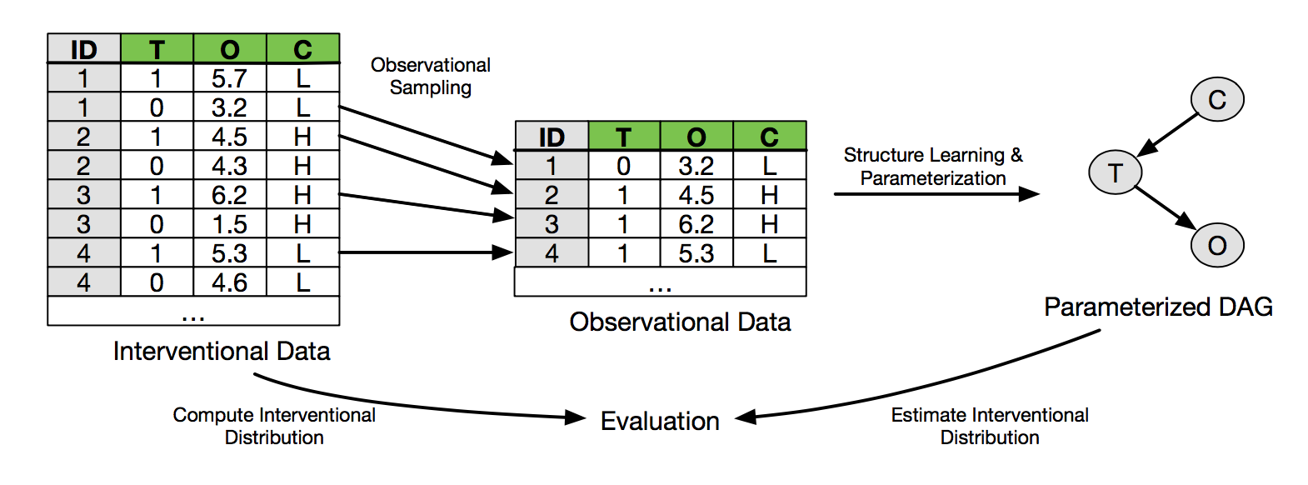
Process

Slide 14
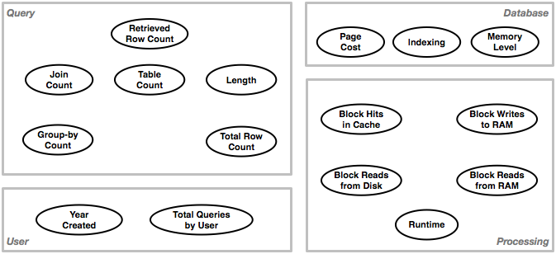
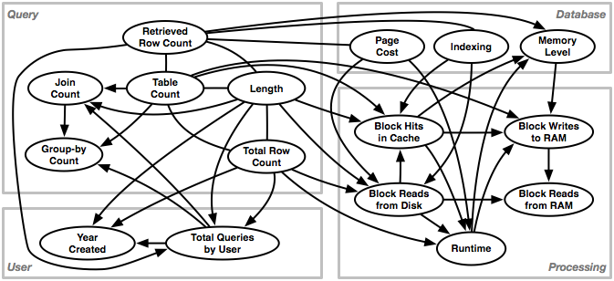
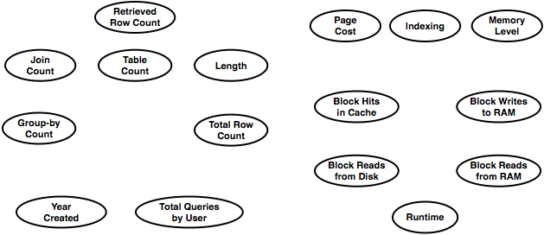
CGM for database configuration

Slide 15
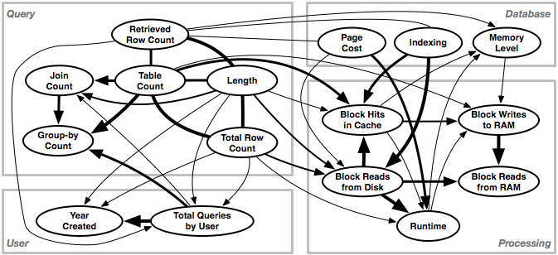
CGM for database configuration

Slide 16
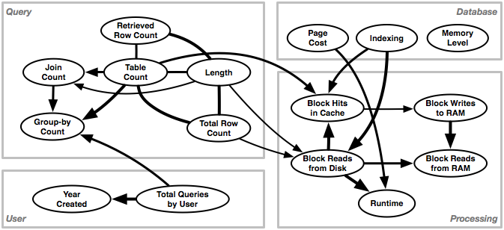
CGM for database configuration

Slide 17
Comparing associational and causal models
Compare a state-of the-art associational model (a random forest) to a CGM constructed using greedy equivalence search (GES) (Chickering & Meek 2002)
Evaluate by comparing to “ground truth” (experimental results for all queries obtained using a specific joint setting of the configuration parameters).
Cache Hits
(Garant & Jensen 2016)

Slide 18
Comparing associational and causal models
Compare a state-of the-art associational model (a random forest) to a CGM constructed using greedy equivalence search (GES) (Chickering & Meek 2002)
Evaluate by comparing to “ground truth” (experimental results for all queries obtained using a specific joint setting of the configuration parameters).
Cache Hits
(Garant & Jensen 2016)

Slide 19
Comparing associational and causal models
Compare a state-of the-art associational model (a random forest) to a CGM constructed using greedy equivalence search (GES) (Chickering & Meek 2002)
Evaluate by comparing to “ground truth” (experimental results for all queries obtained using a specific joint setting of the configuration parameters).
Disk Reads
(Garant & Jensen 2016)

Slide 20
Comparing associational and causal models
Compare a state-of the-art associational model (a random forest) to a CGM constructed using greedy equivalence search (GES) (Chickering & Meek 2002)
Evaluate by comparing to “ground truth” (experimental results for all queries obtained using a specific joint setting of the configuration parameters).
Disk Reads
(Garant & Jensen 2016)

Slide 21
Comparing associational and causal models
Compare a state-of the-art associational model (a random forest) to a CGM constructed using greedy equivalence search (GES) (Chickering & Meek 2002)
Evaluate by comparing to “ground truth” (experimental results for all queries obtained using a specific joint setting of the configuration parameters).
Runtime
(Garant & Jensen 2016)

Slide 22
Comparing associational and causal models
Compare a state-of the-art associational model (a random forest) to a CGM constructed using greedy equivalence search (GES) (Chickering & Meek 2002)
Evaluate by comparing to “ground truth” (experimental results for all queries obtained using a specific joint setting of the configuration parameters).
Runtime
(Garant & Jensen 2016)

Slide 23
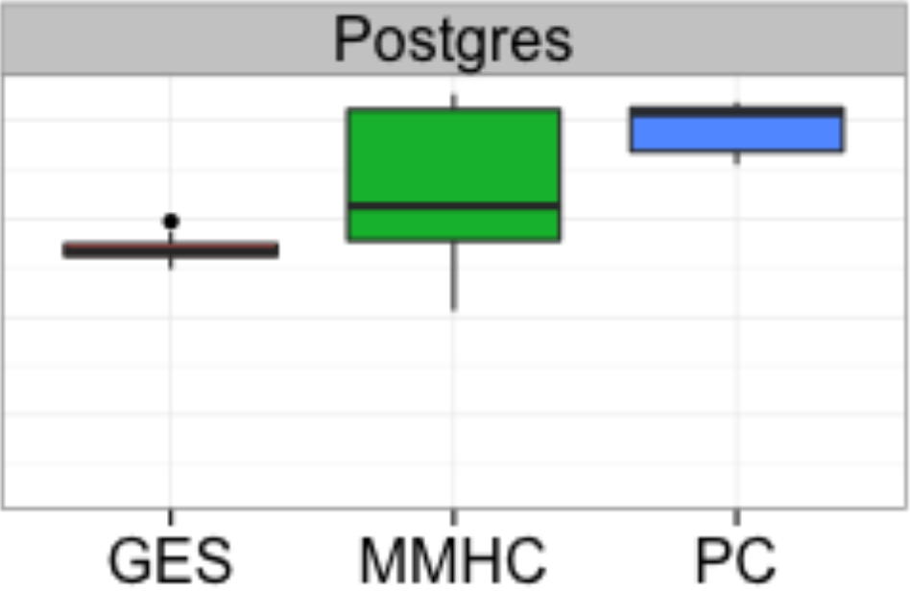
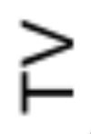
Some conclusions
Existence proof — Existing methods can learn a reasonably accurate causal graphical model of a real system using observational data.
Comparative performance — GES appears to outperform MMHC and PC on this task, both in terms of expected value and variance.
Practical observations — Not all structure errors are created equal. Errors of existence and direction on many edges do not substantially reduce accuracy on estimates of causal effect on this task.

Slide 24
Challenges of evaluating techniques for causal modeling

Slide 25
Predictive accuracy is insufficient
Predictive accuracy on held-out observational data underdetermines accuracy of causal inference.
Predictive accuracy is nearly a necessary condition, but it is not a sufficient condition.
Typically, the interventional distribution differs substantially from the observational distribution.
Thus, observational data alone are insufficient.
This renders insufficient a set of methods for empirical evaluation long-developed and used within the machine learning community (e.g., cross-validation, specific accuracy measures, etc.)

Slide 26
In addition to this technical barrier there are sociological and cultural barriers as well…

Slide 27
Diverse research communities
Several diverse research communities have developed methods for causal inference and modeling from observational data,
These include...
CS, Statistics, Philosophy –> CGMs
Stats, Social Science, Econ –> POF (PS, IV, ITS, etc.)
Physics, CS –> Distributional methods
Each of these communities favors specific task definitions, standards, and traditions

Slide 28
Example: Machine learning
Traditional work in ML makes empirical evaluation look relatively easy
Tasks — Long-studied and widely applicable tasks (e.g., conditional probability estimation)
Evaluation methods — Well-established methods including cross-validation, temporal partitioning of test sets, ROC analysis, etc.
Resources — Large repositories of real-world data sets and software for performing empirical evaluation.
Many other examples in CS: IR (TREC); Robotics (RoboCup); RL (Backgammon); Deep RL (Atari 2600)

Slide 29
What is the task of causal modeling?
One formulation — Given an arbitrary intervention X in a system of interest, estimate the effect on some set of outcomes Y.
However, there are many alternative formulations
Potential Outcomes Framework — Given an intervention on a single binary treatment X, estimate the effect on a single continuous outcome Y.
Reinforcement learning — Given an action policy 𝜋, estimate the long-term discounted reward of following that policy.
Structure only — Determine whether X causes Y.

Slide 30
Structure-only is not well-specified
The structure-only task — “Does X causes Y” — is not a well-specified task.
An answer (“Yes”) for a specific variable pair {x,y} specifies neither the magnitude of effect nor the conditions under which the effect occurs.
Any answer can be valid, given a particular effect-size threshold, sample size, and marginal distribution of other potential causes of y.
A well-specified answer would also specify the strength-of-effect and the conditioning set under which those effects occur.

Slide 31
Current dominant method: Structural evaluation

Slide 32
Current evaluation methods
Multiple types of methods are currently used to evaluate practical techniques for causal modeling
These include:
Theoretical analysis (e.g., soundness and completeness theorems)
Innovative forms of empirical evidence (stay tuned)
However, at least for work on CGMs, one method of evaluation is dominant — Assessing structural accuracy on models learned from synthetic data.

Slide 33
Structural accuracy on synthetic data
Given
A technique T for that constructs a DAG from observational data
A fully specified causal graphical model M* consisting of a DAG D* and set of CPDs
Generate data Generate a data sample S from M*
Learn model Apply T to learn a DAG DT from S
Evaluate model Compare DT and D* using f(D1,D2)

Slide 34
Structural measures
Evaluate existence of false positive and false negative edges as well as edge orientation errors.
Simple measures
False positive and false negative rates
Rates of edge orientation errors
Precision and recall; oriented precision and recall
Summary measures
Structure Hamming distance
Structural intervention distance

Slide 35
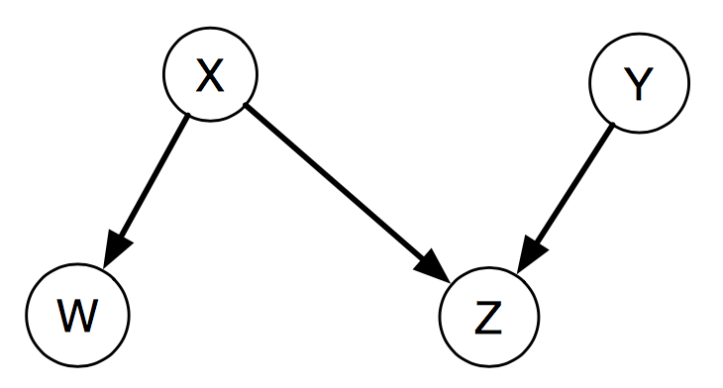
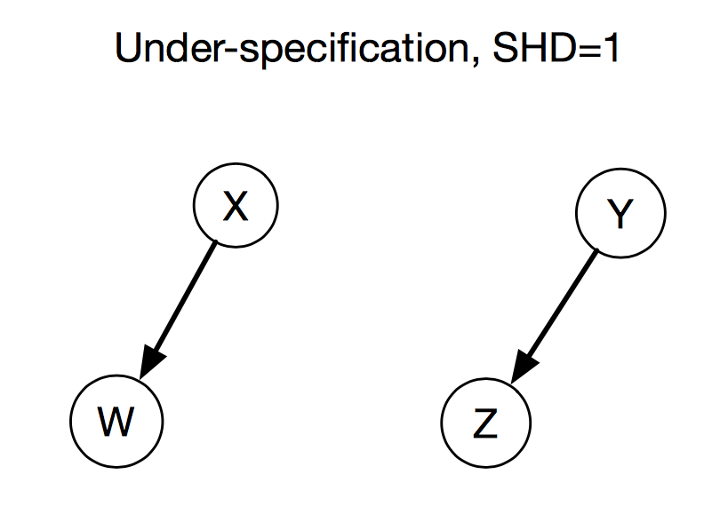
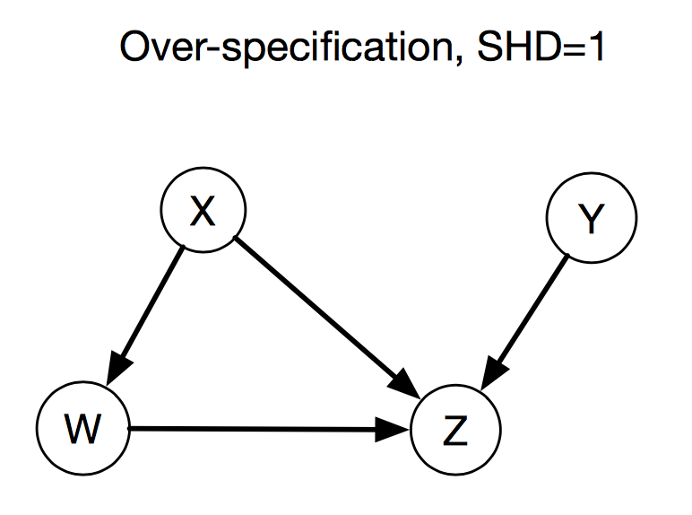
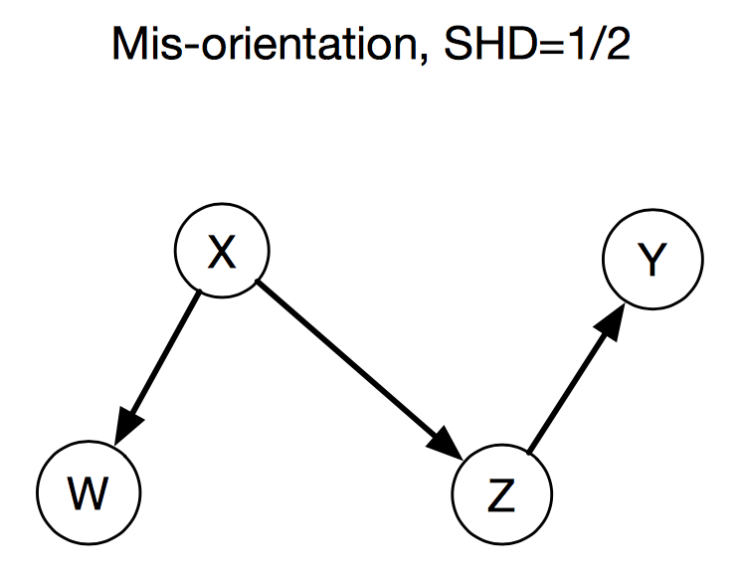
Structural Hamming Distance (SHD)
(Tsamardinos et al. 2006; Acid and de Campos 2003 )

Slide 36
Structural intervention distance (SID)
Graph mis-specification is not fundamentally related to quality of a causal model (Peters & Bühlmann 2015)
Including superfluous edges does not necessarily bias a causal model
Reversing or omitting edges can potentially induce bias in many interventional distributions
Core idea — Count the number of mis-specified pairwise interventional distributions

Slide 37
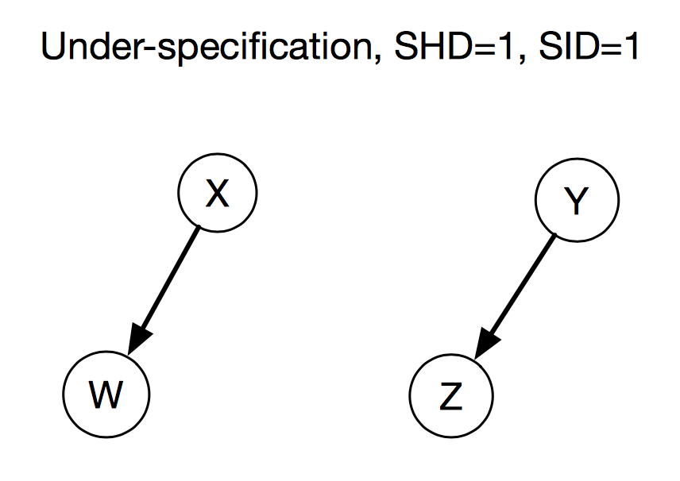
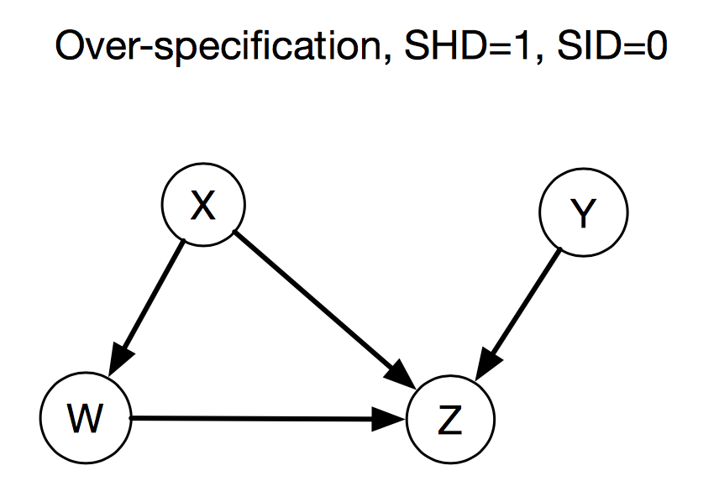
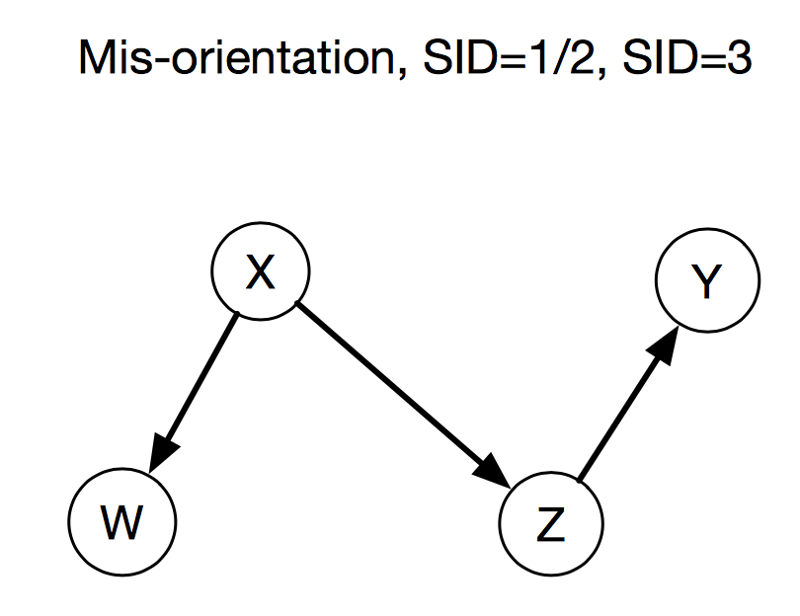
Structural Hamming Distance (SHD)
P(Z|do(X))
P(Y|do(X)) P(Z|do(Y)) P(Y|do(Z))

Slide 38
Limitations and detrimental effects of our current approach

Slide 39
Loosely coupled to a well-specified task
Structural accuracy is neither necessary nor sufficient for high-accuracy estimates of causal effects
Not necessary — Many edges may have no effects or very small effects on causal paths from interventions to outcomes.
Not sufficient — Either errors on very strong edges or entirely correct structure with incorrect parameters can still produce poor estimates of causal effect.
SHD is unfocused in that you cannot specify treatments and outcomes of interest (although SID can do this)

Slide 40
CGM for database configuration

Slide 41
Limits comparison of representations
Structural measures artificially limit model representation to Bayesian networks.
They essentially “bake in” the DAG representation of a causal model
An ideal evaluation method would be representation agnostic (e.g., cross-validated accuracy in conditional probability estimation)

Slide 42
Prevent use of empirical data sets
Structural measures require knowledge of the correct structure, meaning either...
...Artificial data generator in the form of a DAG; or
...Extraordinary knowledge of a real-world generative process
Prevents impressive applications
No use of real data sets that speak to researchers outside of the community
Examples — Atari 2600, TDGammon, SkyCat

Slide 43
No surprises about the real-world effects
Essentially no use of real data sets
Use of empirical evaluation is important because, in some cases, intuitively plausible learning methods actually lead to worse performance. (Minton 1985; Langley 1988).
Essentially all techniques for causal modeling are sufficiently complex that formal analysis cannot tell us everything about their behavior.

Slide 44
Alternatives

Slide 45
Alternatives
Compare interventional distributions on synthetic data (e.g., TV)
Compare interventional distributions on synthetic data intended to represent real data
BNs learned from real data
DARPA program with social science simulations
Compare inferences in empirical cases with known causality (e.g., Cause-Effects Pairs Challenge)

Slide 46
Alternatives (continued)
Compare interventional distributions on real data with limited sets of real-world interventions
Arabidopsis data
DREAM data
Compare interventional distributions on real data with exhaustive experimental data from closed systems (e.g., Postgres, HTTP, JDK)
Doubly randomized controlled trials (Shadish)

Slide 47
Interventions

Slide 48
Where should we go?
Existence of alternatives
Dataset development from systems in which extensive experimentation is possible
Cyber-physical
Small-scale biological systems
…and even standard synthetic data generators
Standardized evaluation protocols
Availability — Creation of shared repositories with version numbers, etc.
Use — Authors, reviewers, and readers who use the approaches

Slide 49
Potential outcomes

Slide 50
Where could this lead?
Wider recognition of method utility outside of the field (e.g., DeepMind Atari paper, SkyCat)
Clearer sense of comparative effectiveness of alternative methods
Most QEDs can’t represent effects of combined interventions
CGMs don’t exploit many types of prior knowledge about data generating process (e.g., within-subjects designs)
Many distributional methods don’t estimate size of effect or account for confounding

Slide 51
Where could this lead? (continued)
Identification of relative importance of key assumptions
e.g., NBC and conditional independence assumption
e.g., Effects of measurement error (Scheines)
Identification of additional, unrecognized assumptions
Development of methods that unify multiple traditions in causal inference

Slide 52
Conclusions

Slide 53
The idea
“Our understanding of causal inference, and the impact of practical techniques for causal modeling, would substantially improve if we more regularly conducted empirical evaluation of our practical techniques.”

Slide 54
The idea
“Specifically, we should apply a broader and more consistent set of methods to evaluate the performance of techniques for causal modeling. These should include theoretical analysis, simulation, and empirical evaluation.”

Slide 55
The idea
“In contrast to theory and simulation, the use of empirical methods is conspicuously absent from most current work. Further development and adoption of such methods offers a major opportunity for improving both the quality of our research and its external impact.”

